Slide 1
14.00-14.45
Wicked challenge: Connecting rural
communities and businesses
Facing the challenges and opportunities for transport in rural communities: Danial Naqvi, Senior Policy Advisor, Future
Transport Systems & Environment, DfT: Tackling social exclusion in transport: Sharon Payne, Rural Mobility Centre of Excellence, Transport East
Insights from pilot and intervention trials in the South West: Tom Jarvis, Senior Evidence and Analysis Officer, TfN
Ways to build better evidence for rural areas: Hannah Fountain, Western Gateway STB
Ways to build better evidence for rural areas: Richard Bradley, Head of Strategy, Midlands Connect
^{WITH}
^{SUPPORTED BY}

Slide 2
Challenges
Trends
Opportunities
Choice
New modes
Embrace innovation
Commercial
Improve accessibility
Sustainability
Isolation
Transform services
Changing demand
Planning
Active travel
Access to services
Digitalisation
Freight, logistics, agri-tech

Slide 3
Innovation in rural areas – the future of rural transport
The Industrial Strategy (2017) set a challenge for the UK to become a world leader in future transport technologies.
2017
Industrial Strategy
The objectives of the Future of Transport programme have been shaped by this initial challenge, as we look to support emerging technologies as a way to improve the transport system and support decarbonisation of the transport sector.
2018
This led to the publication of our Urban Strategy (2019) and the creation of our nine future transport principles to guide the introduction of new technologies and modes.
2019
Urban Strategy
This includes regulatory reform, trialling and experimentation, research and evidence gathering, and guiding our investment and funding decisions.
In 2020 we consulted on a Rural Strategy, with our Call for Evidence looking at the opportunities and challenges posed by future transport issues across rural, semi-rural, and remote communities.
2020
Rural Strategy
After a pause for Covid-19 reprioritisation, we published our Future of Transport: supporting rural transport innovation guidance, along with £3 million of R&D funding.
2023
2

Slide 4
Rural Mobility Centre of Excellence

Slide 5
Rural Mobility Centre of Excellence
Practical advice and support
Improved decision making
Bespoke to our region
Capacity and capability
Economies of scale
Better communication

Slide 6
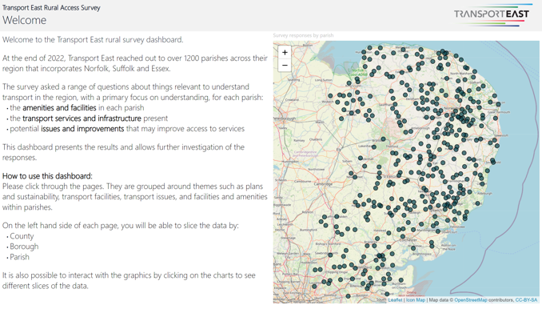
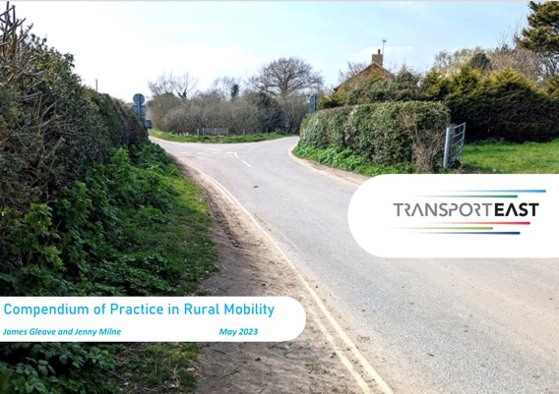
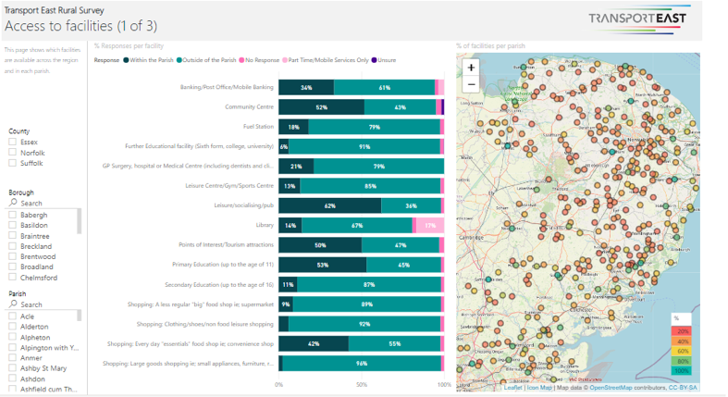
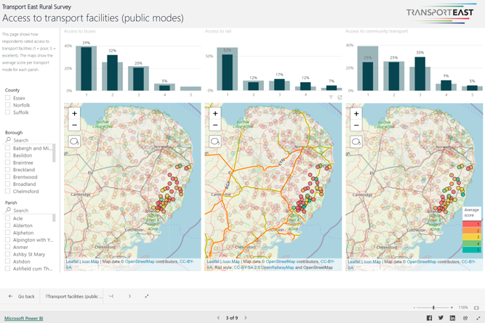
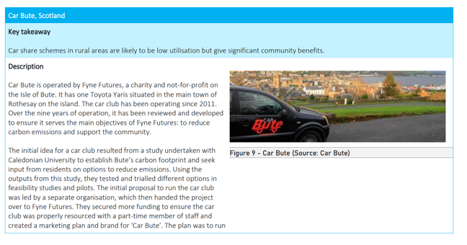
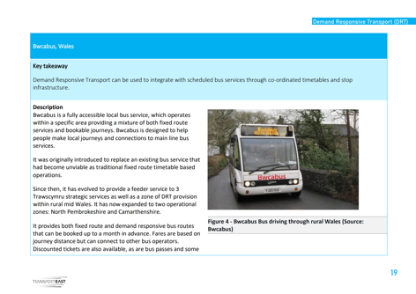
Building the Evidence Base

Slide 7
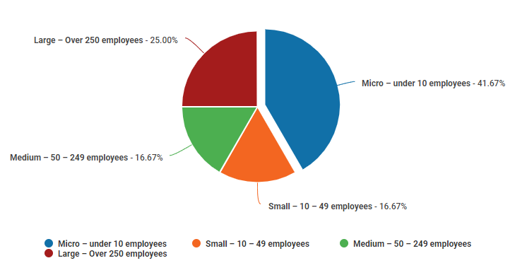
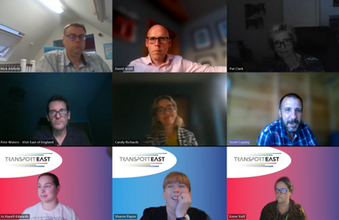
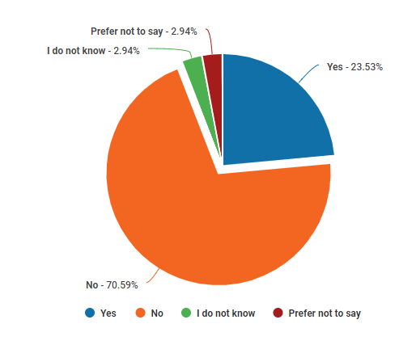
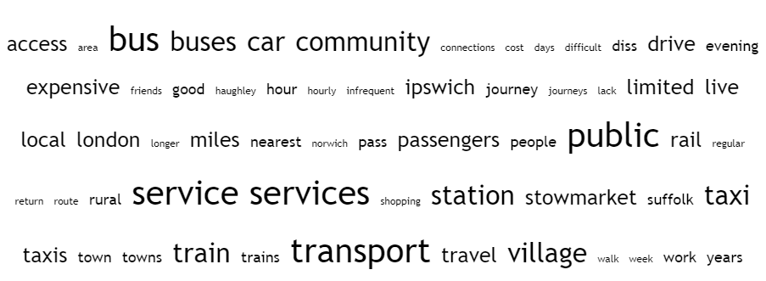
Strategy Hub
Recommendations
Central Government
Local Government and other public sector service providers
Transport East and Partners

Slide 8
Rural bus services have seen major cuts since 2010. Service mileage is:
Down 28% in largely or mainly rural areas in Great Britain
Down 40% in Cumbria, North Yorkshire, & Northumberland
Data source: TfN analysis of DfT BUS02

Slide 9
Local Authority supported services in rural areas have seen the largest cuts. Service mileage is:
Down 34% in urban metro areas outside of London
Down 56% in largely or mainly rural areas in Great Britain
Down 79% in Cumbria, North Yorkshire, & Northumberland
Data source: TfN analysis of DfT BUS02

Slide 10
Rural Mobility Pilots in South West: Early Findings
Hannah Fountain
Senior Transport Officer
Western Gateway STB

Slide 11
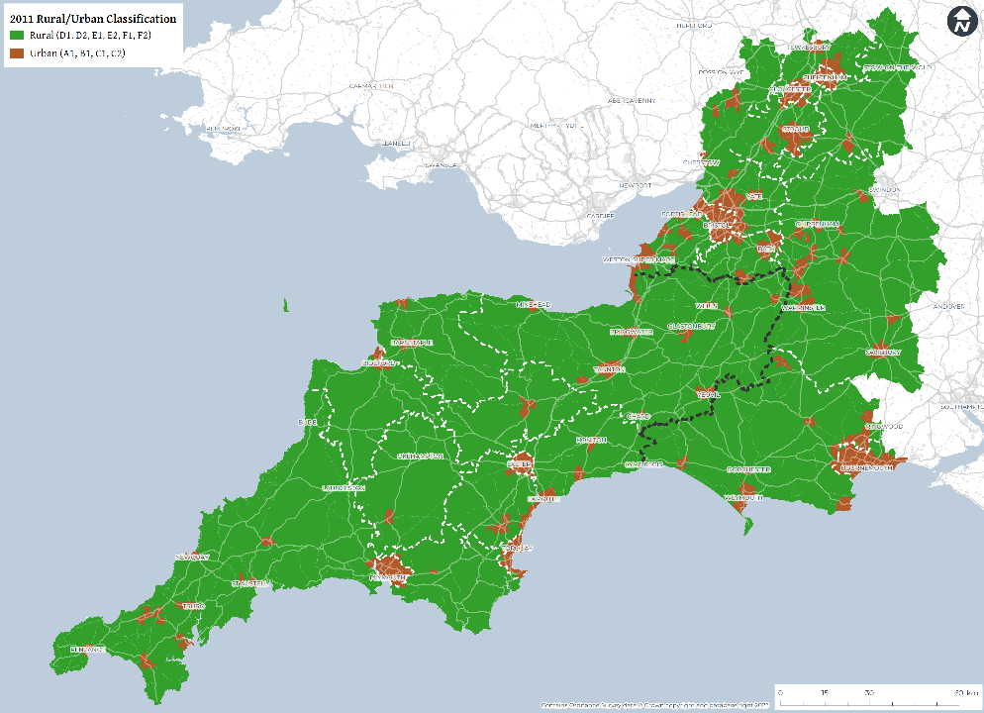
Rural travel in South West:
A third of people live in a rural location (1.8M people), twice UK av.
Rural residents drive twice as far p.a. as urban (87% journeys by car)
Older and ageing population
Potential to shift modes only around half of that in urban areas
Big variation in seasonal travel demand
South West Rural Mobility Strategy (2022)

Slide 12
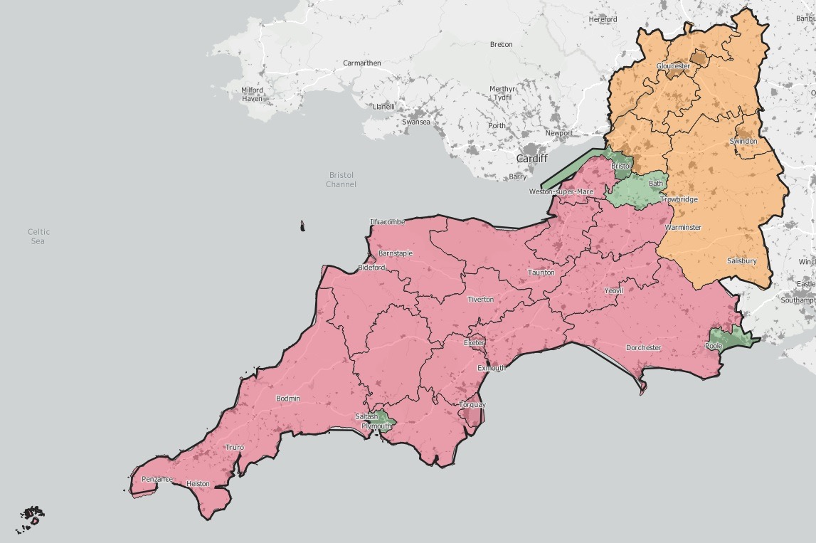
Seasonal variation AADT
<15%
15-25%
>25%

Slide 13
Learnings from inaugural Rural Mobility event
Organisation | Success criteria
 | Political support Integration of modes
 | Cross-boundary, multi-purpose service planning. Continuous investment
 | Integrated proposition across operators. Technology – planning and purchasing Identification of new markets and cooperative pursuit
 | Growth market for PT – viability Capacity constrains innovation Importance of community contribution

Slide 14
Learnings from inaugural Rural Mobility event
}
Organisation | Success criteria
 | Political support Integration of modes
 | Cross-boundary, multi-purpose service planning. Continuous investment
 | Integrated proposition across operators. Technology – planning and purchasing Identification of new markets and cooperative pursuit
 | Growth market for PT – viability Capacity constrains innovation Importance of community contribution
Political support
Cross-boundary and cross-sector working
Innovation and market growth
Funding

Slide 15
Learnings from inaugural Rural Mobility event
Organisation | Success criteria | STB role
 | Political support Integration of modes | Advocacy and representation: Constituent Members DfT
 | Cross-boundary, multi-purpose service planning. Continuous investment | Facilitating and convening: Cross-boundary planning and development Multi-sector fora
 | Integrated proposition across operators. Technology – planning and purchasing Identification of new markets and cooperative pursuit | Research and Innovation: Market research (with industry partners) Data gathering Develop viable innovative propositions Pilots Knowledge sharing - Centre of Excellence
 | Growth market for PT – viability Capacity constrains innovation Importance of community contribution | Funding and delivery: Fund identification Consortium building Funding bids/business case development/making case for investment Shared procurement

Slide 16
Ways to build better evidence for rural areas
Richard Bradley, Midlands Connect

Slide 17
Convention
Levelling-up the evidence
Bigger problems
Higher value markets
Time savings focus
More perfect competition
Urban agglomeration
Infrastructure to build on
Budget for tailormade tools

Slide 18
Convention
Levelling-up the evidence
Rural Issues
Bigger problems
Higher value markets
Time savings focus
More perfect competition
Urban agglomeration
Infrastructure to build on
Budget for tailormade tools
Smaller, fragmented issues
Markets missing & lower value
Quality of life different
More transport market failures
Fragmented supply-chains
Greater cost in getting started
More expensive tools

Slide 19
Convention
Levelling-up the evidence
Rural Issues
Better for Rural
Bigger problems
Higher value markets
Time savings focus
More perfect competition
Urban agglomeration
Infrastructure to build on
Budget for tailormade tools
Smaller, fragmented issues
Markets missing & lower value
Quality of life different
More transport market failures
Fragmented supply-chains
Greater cost in getting started
More expensive tools
Represent traveller experience
Represent markets better
Measure what matters
Rural economic narratives
More localised agglomeration
Deliver the easy with the hard
Enable tailored solutions

Slide 21
We want to continue supporting rural areas to tackle transport challenges using innovation.
This fund will help us do that.
Understanding how technology and innovation can support rural challenges will help future policy making, funding, and planning.
This is why we’ve:
published our rural innovation guidance
launched the £2m rural transport accelerator
ring-fenced £1 million for rural projects as part of the Decarbonisation Demonstrators Fund
delivered the £20 million Rural Mobility Fund
Evidence building
Learning from experience
Embracing innovation
Place-based approach
Supporting industry

