Slide 1
11.50-12.35
Wicked challenge: Freight
^{Framing the challenge}
Darren Briggs, Global Logistics, Freight and Supply Chain Leader, Arup
^{STBs’ collective expertise}
Mark Valleley, Head of Strategy, TfSE
^{WITH}
^{SUPPORTED BY}

Slide 2
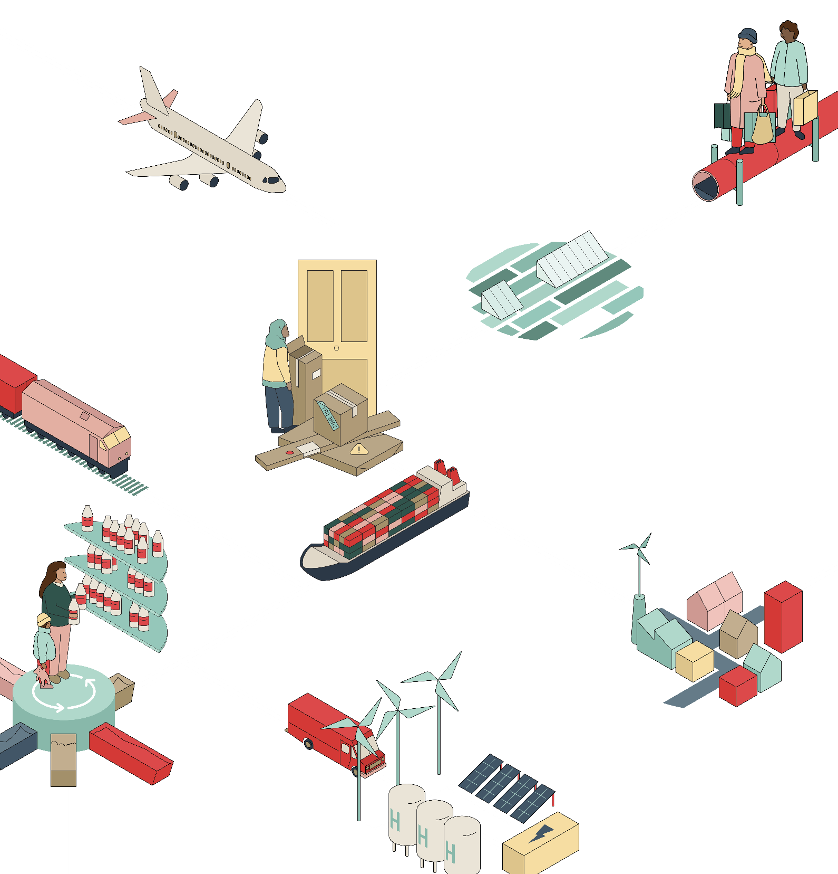
Future of Goods Movement
STB Conference
Darren Briggs| Logistics Lead
Feb, 2024

Slide 3
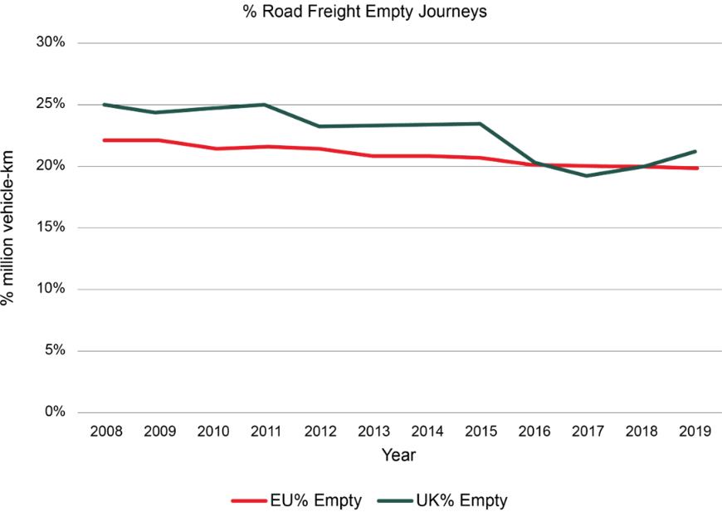
Current freight network is increasingly inefficient, complex, and precarious.
Carbon-intensive: Road transport dominates inland freight
Domestic freight distances in the UK have increased over time
Inefficient and empty trips are significant
Complex operations and reactive decision-making
Increasingly precarious
.

Slide 4
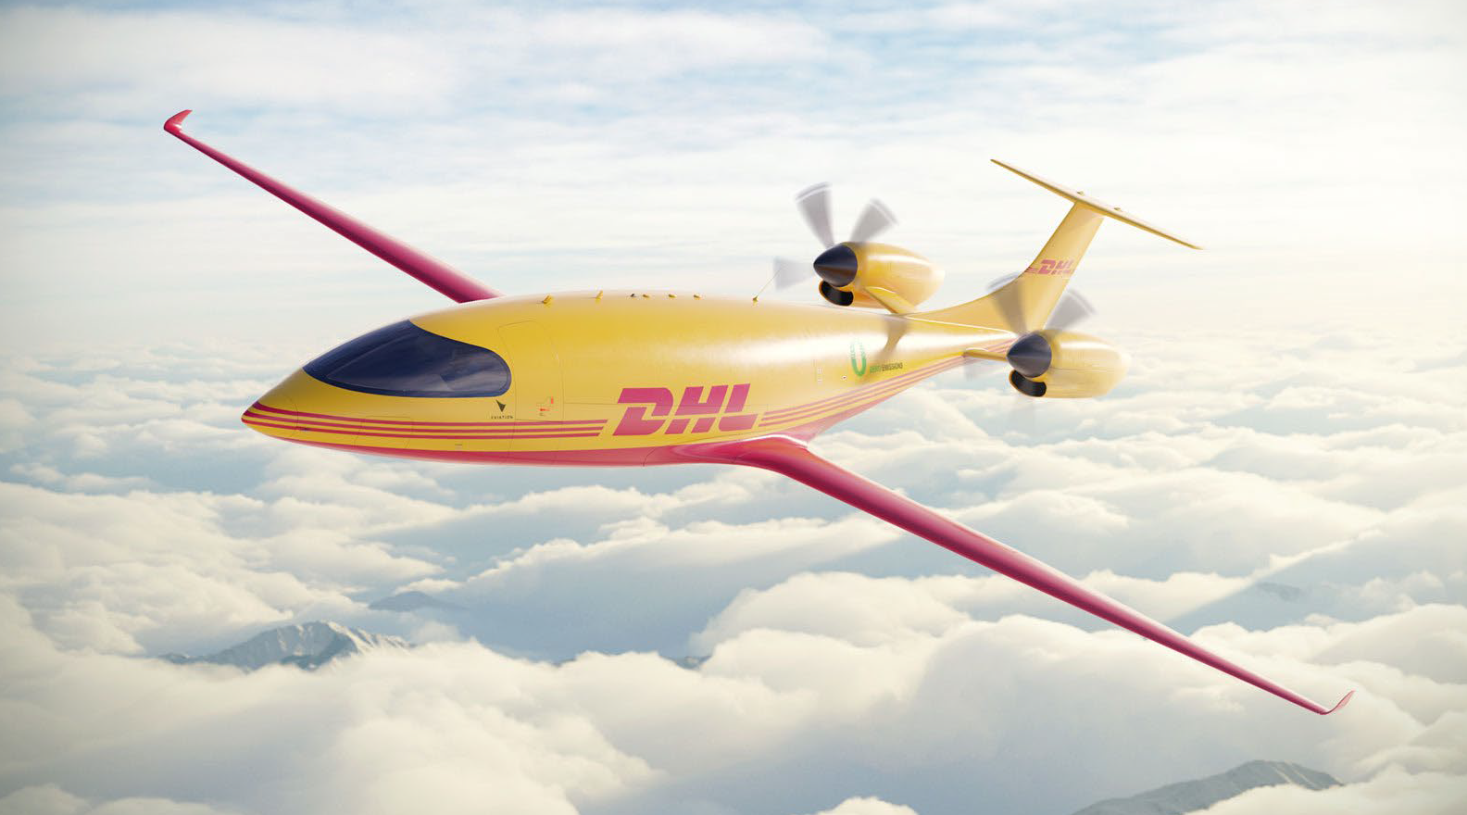
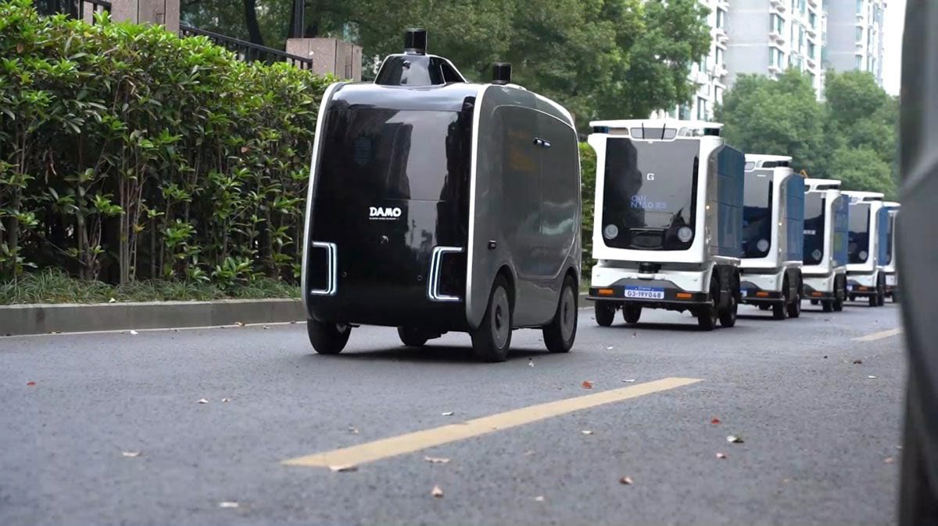
Drivers and trends over the next 50 years
The transition to net zero emissions and the need to transform management of overconsumption and waste
The need to prioritise resilience against growing environmental, social, and economic risks
The changing nature of global economic power and the role of different nations in consumption and production
New technology and changes in supply chains, consumer preferences, and retail business models
The energy and industrial materials transition

Slide 5
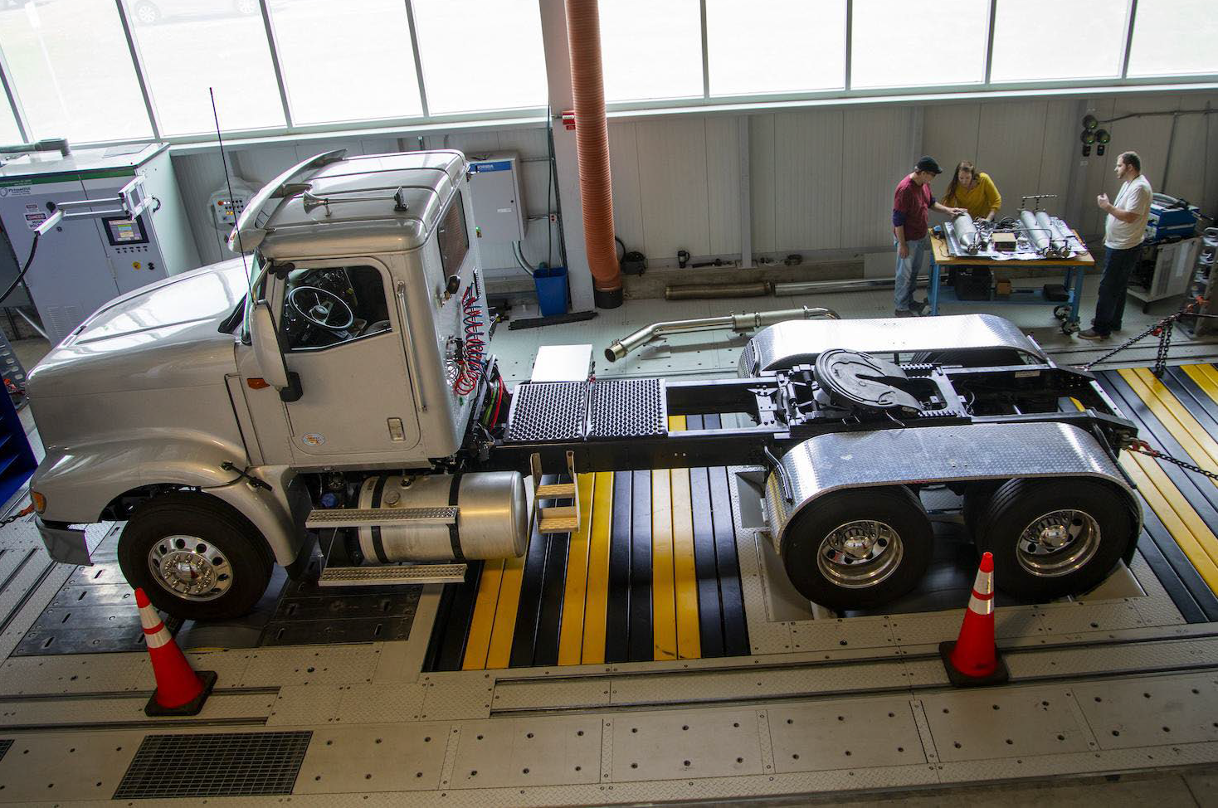
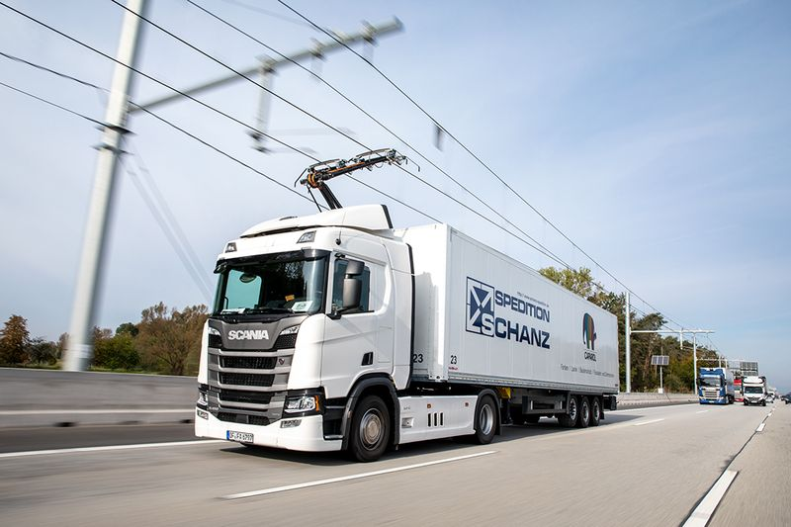
Future of Road
Continue as a means of highly flexible transport capacity
Coordinated policy and implementation to align with net zero commitments
Navigating competitive landscape against new and rising lower carbon transport alternatives
Enhancing resilience through focus on routes, labour (drivers), and energy sources (infrastructure).
Sharing information and deploying technology to maximise vehicle load factors.
Include provision of facilities in urban areas to allow for transfer of goods to more flexible and agile transport modes.

Slide 6
Future of Shipping
Will continue to be the mode of transport for low value freight over long distances
More inland and short sea shipping due to its energy efficiency
Choice of fuel for shipping decarbonisation to reach global net zero targets by 2050
Global variation in demand for bulk shipping and more localised trade
Resilient and connected ports for sustainable and undisrupted goods distribution
Repurposing existing infrastructure to identify opportunities for underutilised assets to generate value

Slide 7
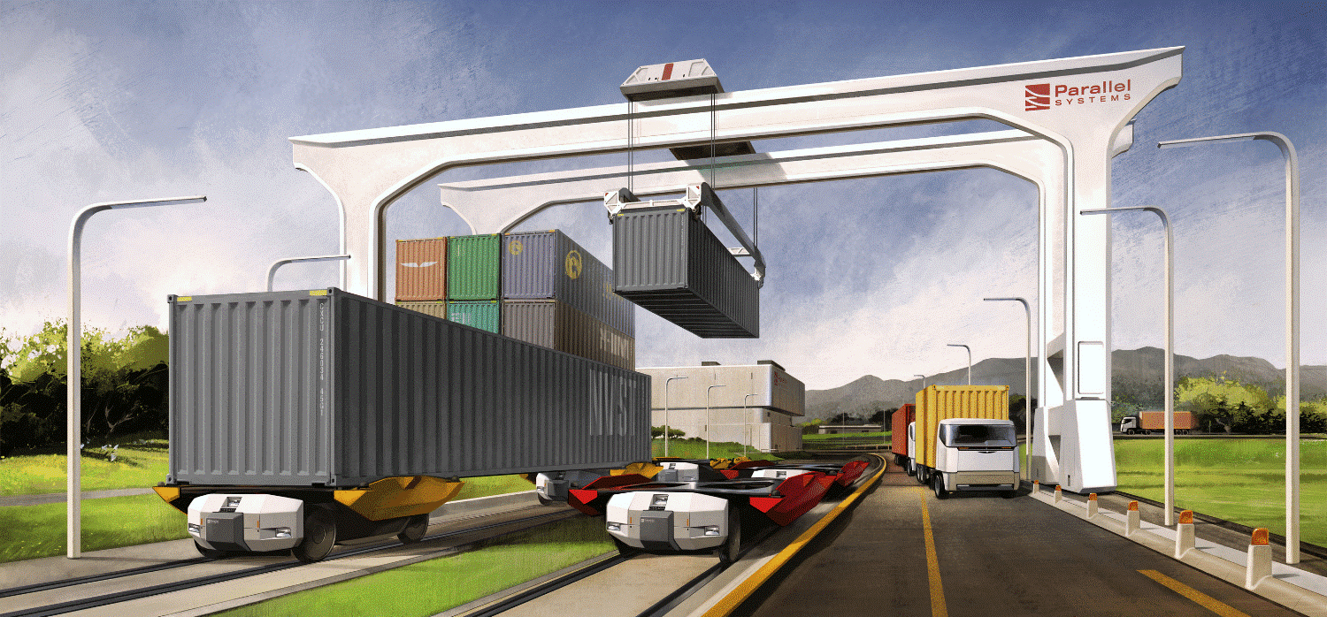
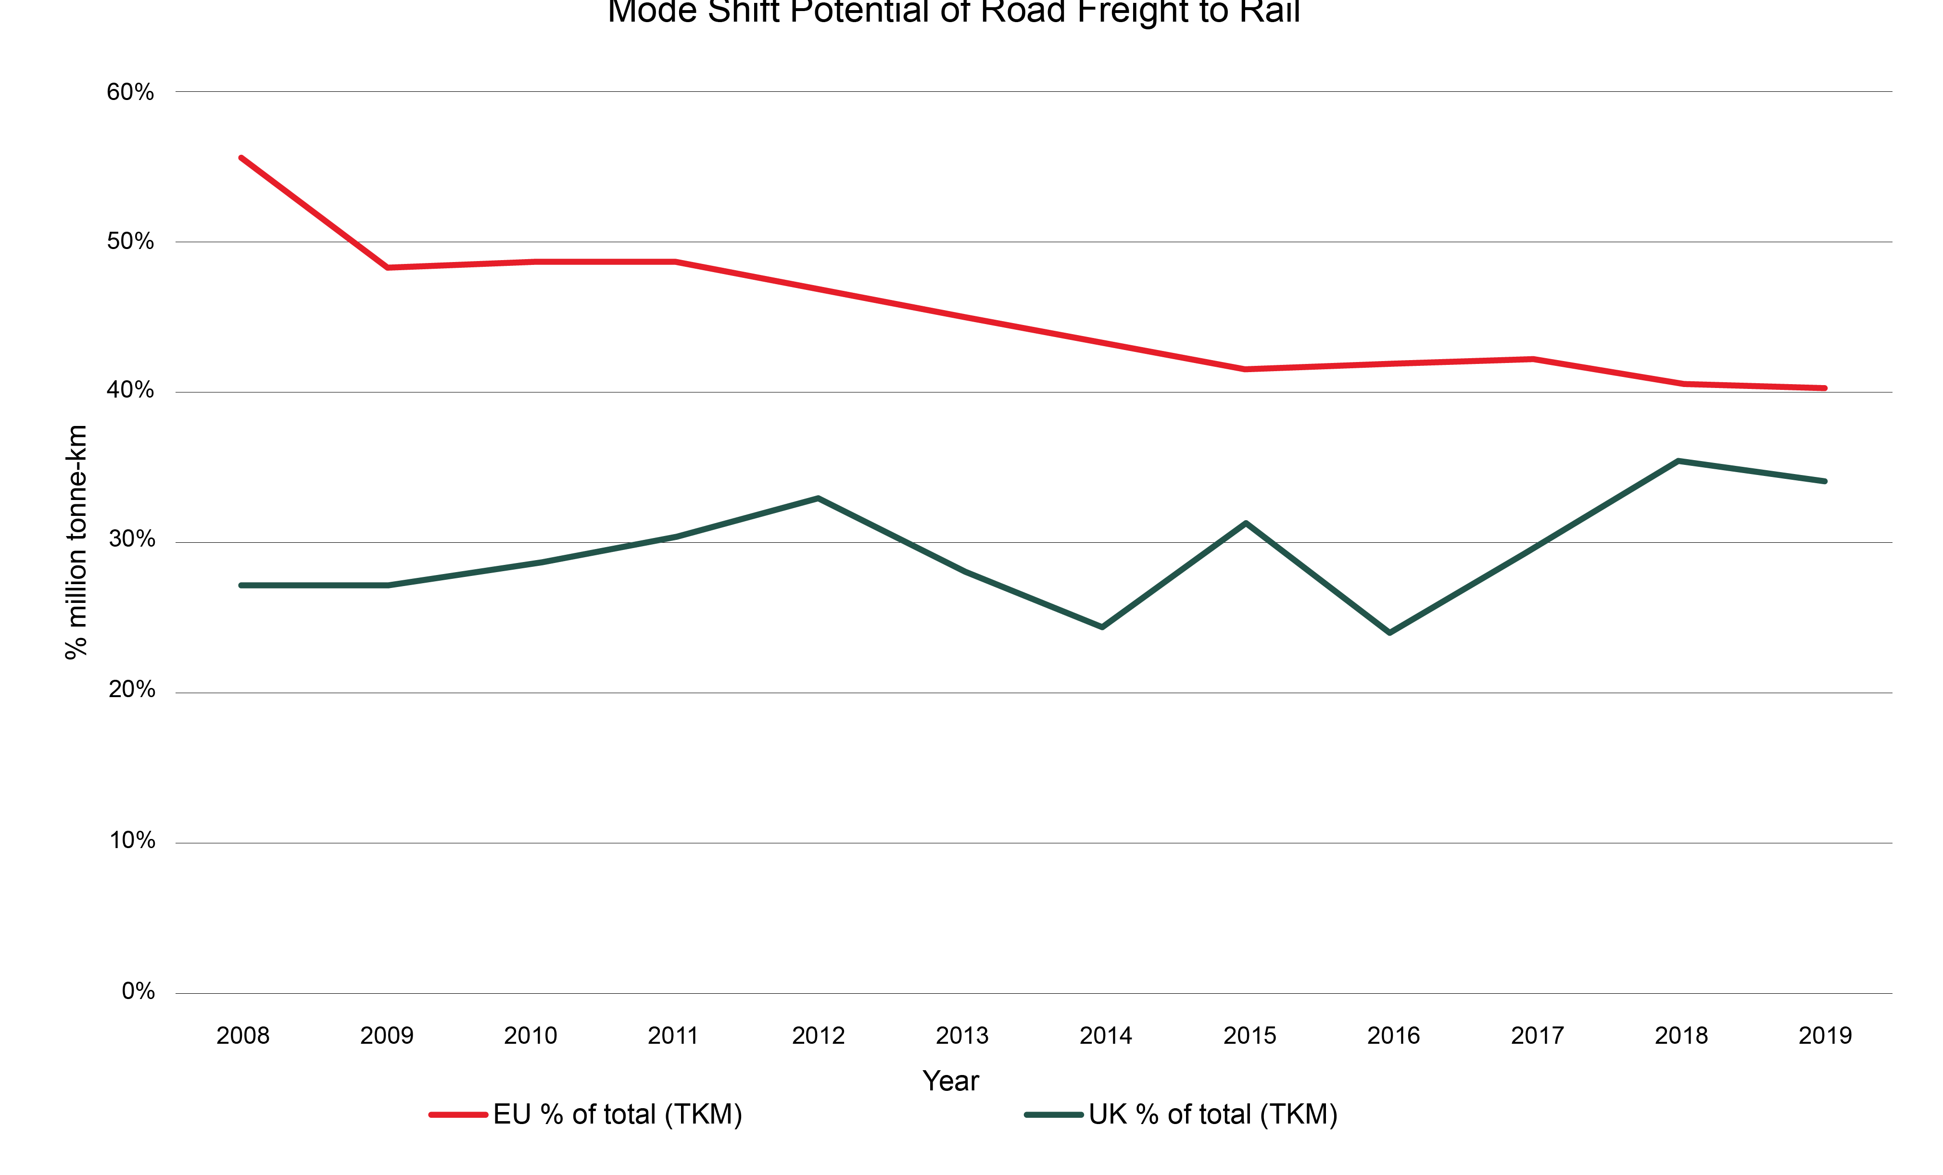
Future of Rail
Rail freight is context-sensitive and needs coordinated industry, transport, and land use policy and planning
Moving large volumes of goods over medium and long distances will continue to be a key market
Rail can deliver major increases in transport capacity on highly congested freight routes.
Need to ensure provision of integrated multimodal freight hubs for optimal utilisation
Keeping up in decarbonisation efforts with other transport modes
Prepare for extreme climate events through design and adaptation of infrastructure and operations

Slide 9
11.50-12.35
Wicked challenge: Freight
TfSE on the challenges of connecting international gateways and collaborating with other STBs via the Freight Forum
Mark Valleley, Head of Strategy, TfSE
EEH/TE’s role in securing improvements at Ely Junction which will open up new rail freight links across the country and North Sea ports
Tim Bellamy, Assistant Director Transport, Cambridgeshire and Peterborough Combined Authority
Untapping rail’s potential, GBRTT freight targets
Richard Moody, Programme Director Freight Reform, GBRTT
^{WITH}
^{SUPPORTED BY}

Slide 10
STB Freight Priorities
Economic Growth
Improving access to and from international gateways
Meeting rail freight growth target with GBRTT & NR
Making the case for freight – inclusion in local plans, LTPs and National Planning Policy Framework Guidance
Decarbonisation
Alternative fuel infrastructure mapping tool
Alignment with wider energy infrastructure planning
HGV - reducing empty running & bridge strikes
Notes:
ALFFI = alternative freight fuel infrastructure – roll out due April 24

Slide 11
STB Freight Priorities
Infrastructure
Lorry parking and driver welfare facilities
Strategic Rail Freight Interchanges
Freeports & opportunities – East Midlands Freeport
Case making for nationally significant freight infrastructure - e.g. Ely rail capacity enhancement
Notes:
Freeports:
MC - East Midlands Freeport (E Midlands Airport and the golden logistics triangle) project looking at the strategic case for transport investment across both road, rail and alignment to energy infrastructure which will cover both movements of goods and people.

Slide 12
STB Freight Priorities
Knowledge sharing & learning
Sharing expertise & best practice
Regional freight forums
Increasing freight awareness in the public sector
National freight model development

Slide 13
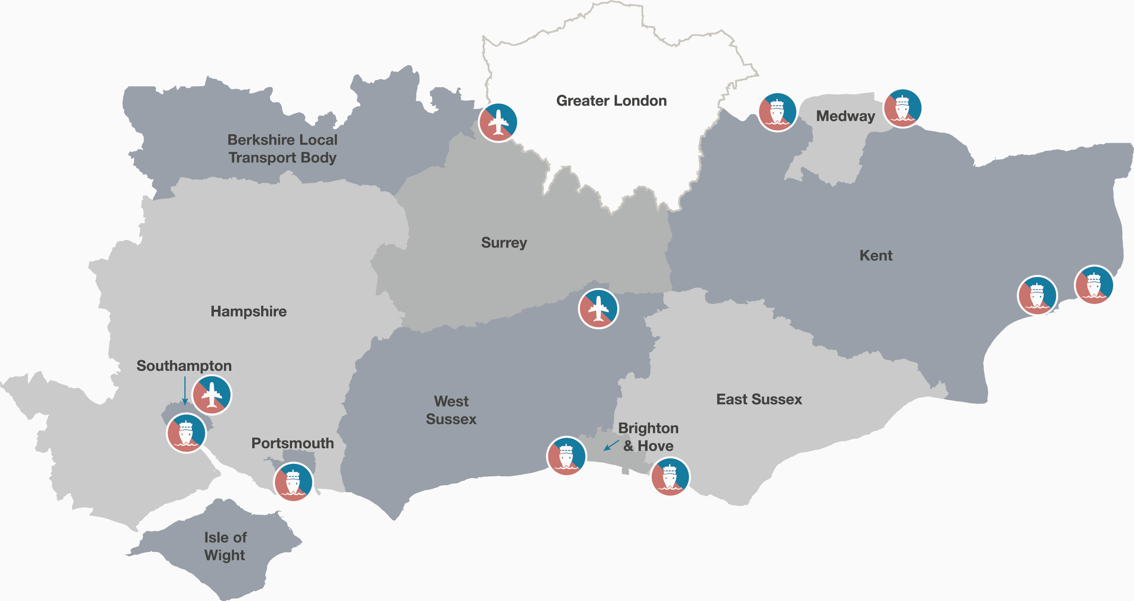
The TfSE Area

Slide 14
