Slide 1



14.45-15.30
Enabling delivery
Midlands Rail Hub: Karen Heppenstall, Head of Integrated Transport, Midlands Connect
Rotherham Station: Graham Kirby, Head of Data Modelling and Appraisal, Transport for the North
Prioritising road investment in the East: Andrew Summers, Chief Executive, Transport East
Preparing for East West Rail: Cllr Jennifer Wilson-Marklew, Milton Keynes Council
South West Rail Resilience Programme: Cllr Andrea Davis, Chair, Peninsula Transport
Heart of Wessex Line: James White, Western Gateway STB
Transport for the South-East's strategic prioritisation tool: Sarah Valentine, Head of Analysis and Appraisal, Transport for the South East
^{WITH}
^{SUPPORTED BY}

Slide 2
Midlands Rail Hub
STB Added Value

Slide 3
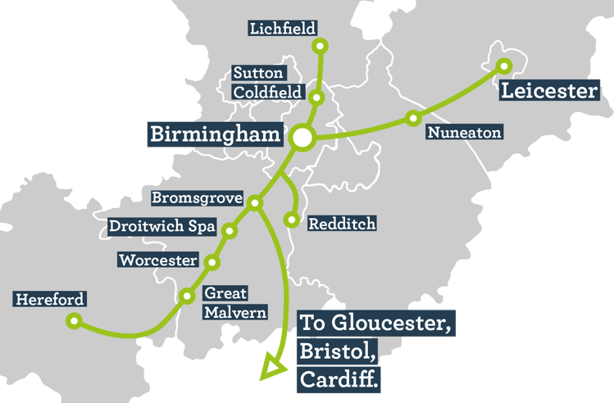
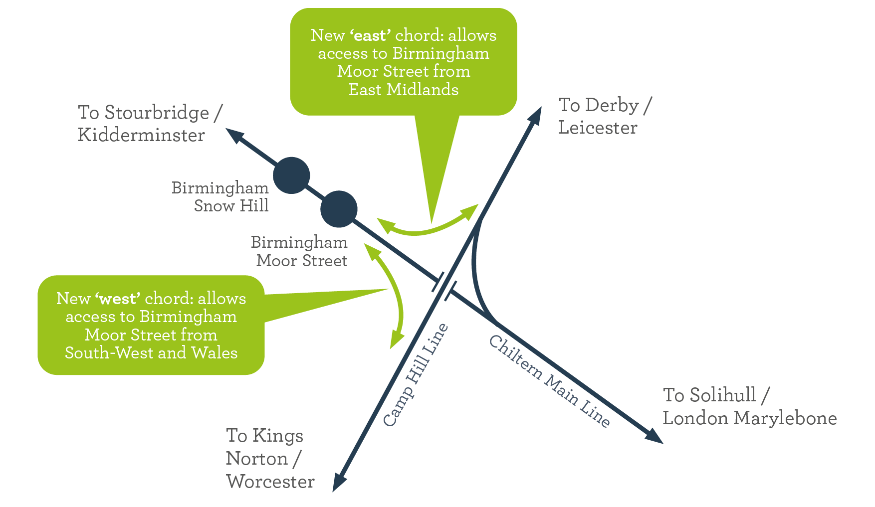
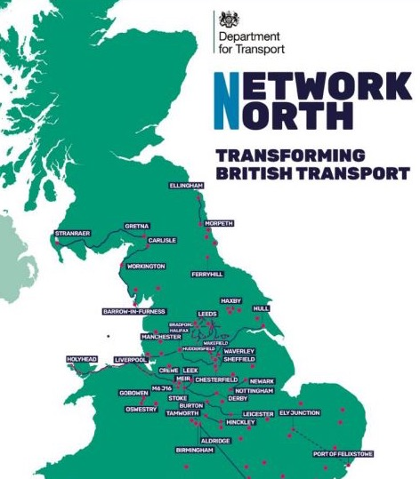

What is Midlands Rail Hub?

Slide 4
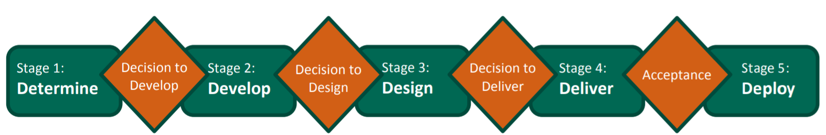
Rail Network Enhancements Pipeline
We are here
Strategic Direction for project
Capital Expenditure on project

Slide 5
Client Partner Role
 | SOBC | OBC | FBC | Delivery
Value | ~£5m | ~£20m | ~£120m | ~£1.75bn
Dates | 2018 → 2019 | 2020 → current | 2024 → 2028 | EiS ~ 2031-2033
MC role | Client | Client Partner (sole) | Client Partner (with others) | Client Partner (with others)
Strategic Rationale
Owner of Strategic Case
Evidence Base (economic, social, environmental)
Stakeholder Engagement
Overall Stakeholder & Comms Strategy
Communication and promotion of strategic rationale
Benefits Realisation
Business Benefits
Partner & Stakeholder consensus

Slide 6




Key Messages
Notes:
STB Added Value – Client Partner role is successful
Collaborative relationships with DfT and Network Rail – takes commitment and hard work

Slide 7

Rotherham Integrated Station
Transport for the North and Rotherham Metropolitan Borough Council

Slide 8
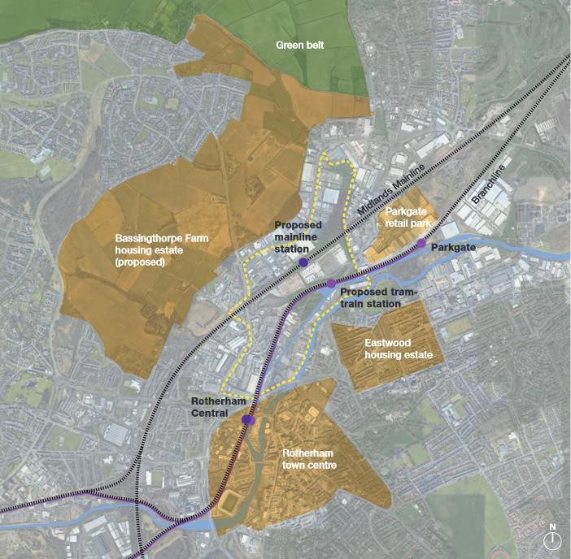

Background to Rotherham Integrated Station
A new station on the Midland Main line to connect Rotherham to the strategic rail network
Adjacent new stop on the Rotherham – Sheffield tram-train line
Significant journey time savings to key centres
Substantial local development activity in close proximity to station

Slide 9
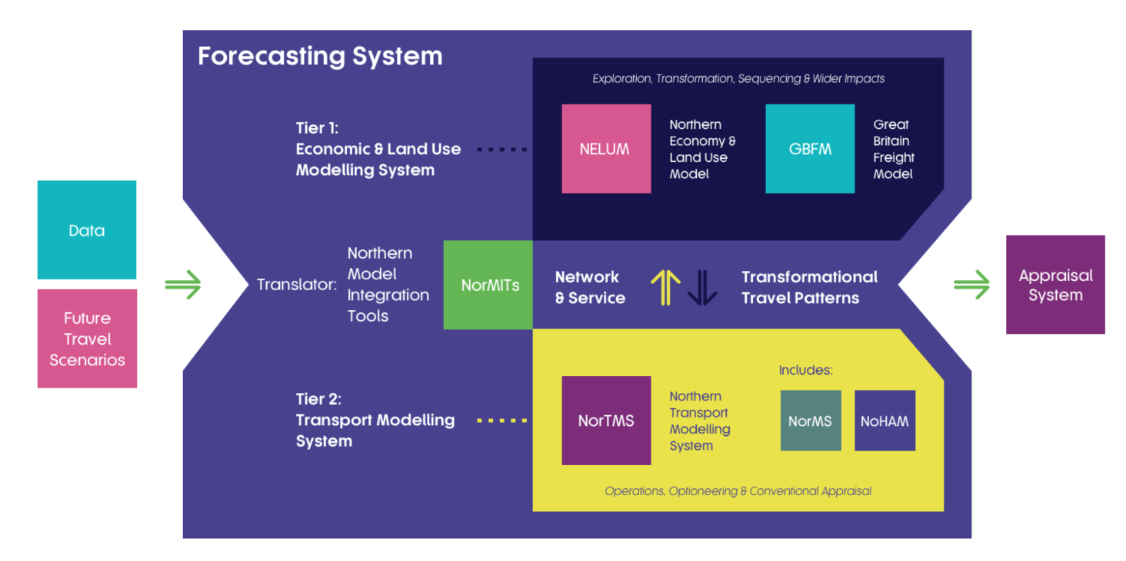
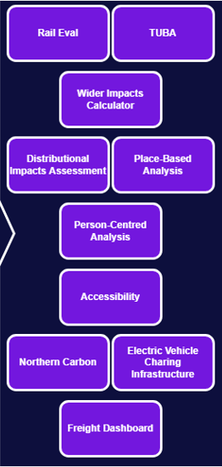
TfN Analytical Framework a consistent approach to data, modelling and appraisal across travel modes and regions of the North

Slide 10
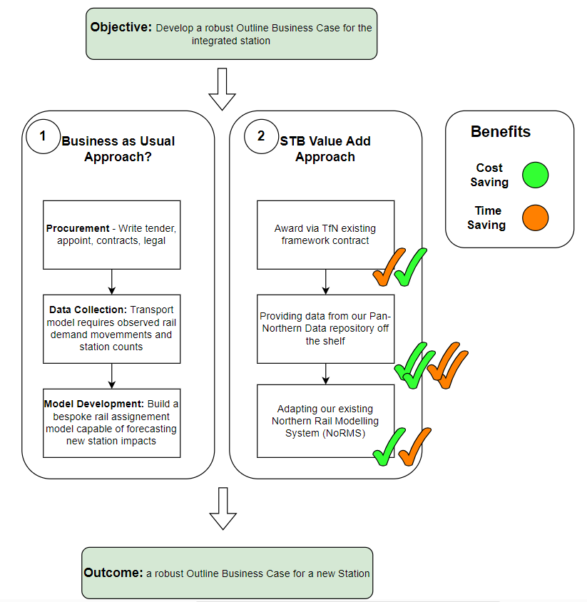

Slide 11
Summary of STB Value Add
We have found a sweet spot of collaboration between a local Partner, STB and the supply chain.
This collaboration has unlocked time and cost savings for Rotherham MBC, permitting the transport modelling and appraisal processes to be completed quicker than a ‘business as usual’ approach
With the underpinning analytics being open source and free of intellectual property the output and skills are retained by the public sector
Evidence from the scheme can play a role in helping the STB move towards the outcomes outlined in our Strategic Transport Plan, via the Strategic Investment Programme
Operating as a middle layer between Central and Local Government, we have been able to bring a local context to the DfT and provide DfT with evidence already technical assured

Slide 12


IDENTIFYING STRATEGIC ROAD PRIORITIES IN THE EAST
Notes:
What, why, where…
Transport East is a sparse area where 1/3 live in rural area. Roads essential to ensure people and goods can move efficiently.
We work with partners to identify road schemes that can support economic and population growth. Benefits private and public transport, freight
Assessment approach demonstrates how Transport East identified best schemes for SRNS and MRNs

Slide 13

Assessment Approach
1
2
3
Strategic Investment Programme development
Assessment against
strategic outcomes
Stakeholder engagement
4
5
6
Agent Based Modelling Analysis
Delivery sequencing and ability to accelerate
Results summary and recommendations to Government
Notes:
Outcomes
Comprehensive list with identified schemes across the region
Provided evidence base to advocate for investment – next slide shows where this is happening
The importance of collaboration, who are the key actors
LTAs and NH. We worked with them and TE works with Gov – sells the bigger picture: investing in identified schemes will boost regional and national economy
how the intervention/work is helping to improve or unlock better connectivity in their region
Made the case for investment. Network North funding for schemes announced in October
How you have used your evidence-based approach and regional knowledge to make better targeted interventions/policy/investment decisions etc
Single voice and successes in raising awareness with DfT ministers
Emphasise your role and what you brought to the table in enabling the project to come together.
We have an endorsed strategy – these schemes support priorities to decarb, connect, unlock and energise.

Slide 14
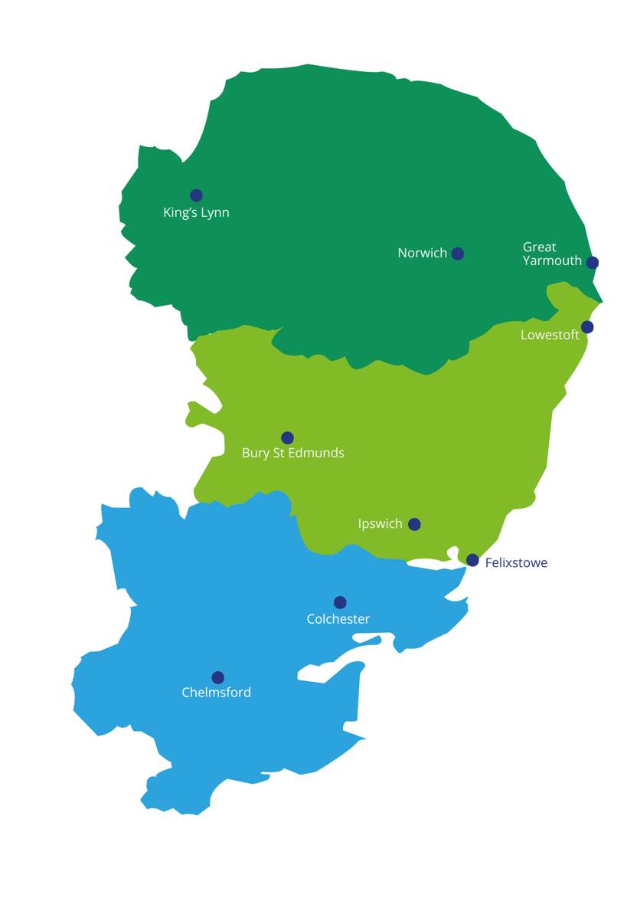
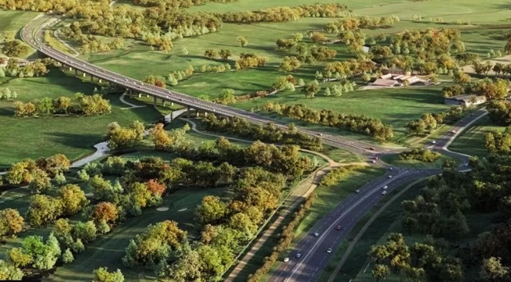
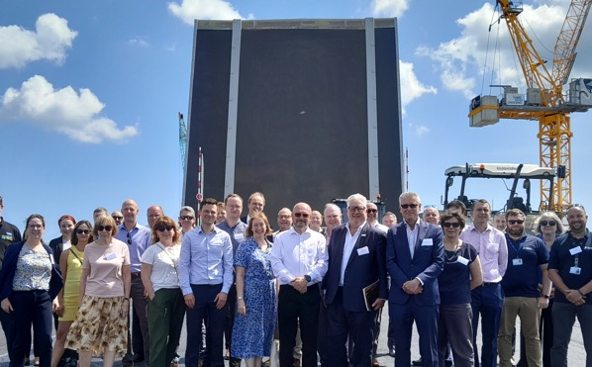
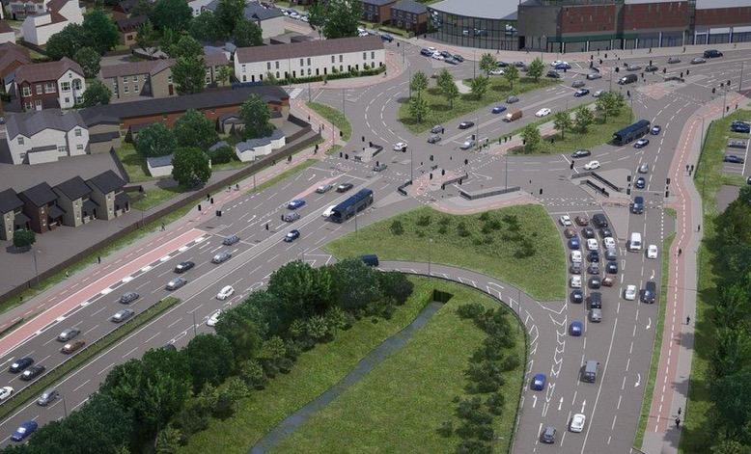

Successes in the East
Norwich Western Link
Third River Crossing Bridge,
Gt Yarmouth
A12 Dualling and upgrades,
Ipswich and Woodbridge
A12 Widening in Essex
Army and Navy Junction,
Chelmsford
Notes:
These are examples of schemes across the East which are progressing
Whiz through to demonstrate the geography for those unfamiliar and case studies of schemes that have the go ahead
Integration of schemes is important – especially with EV and rail
We championed these through assessment – great success but still more to do.

Slide 15
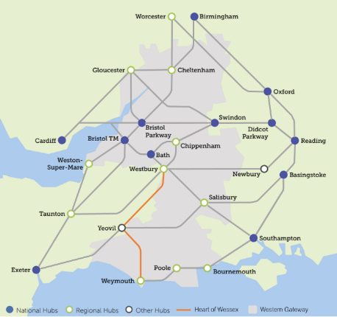
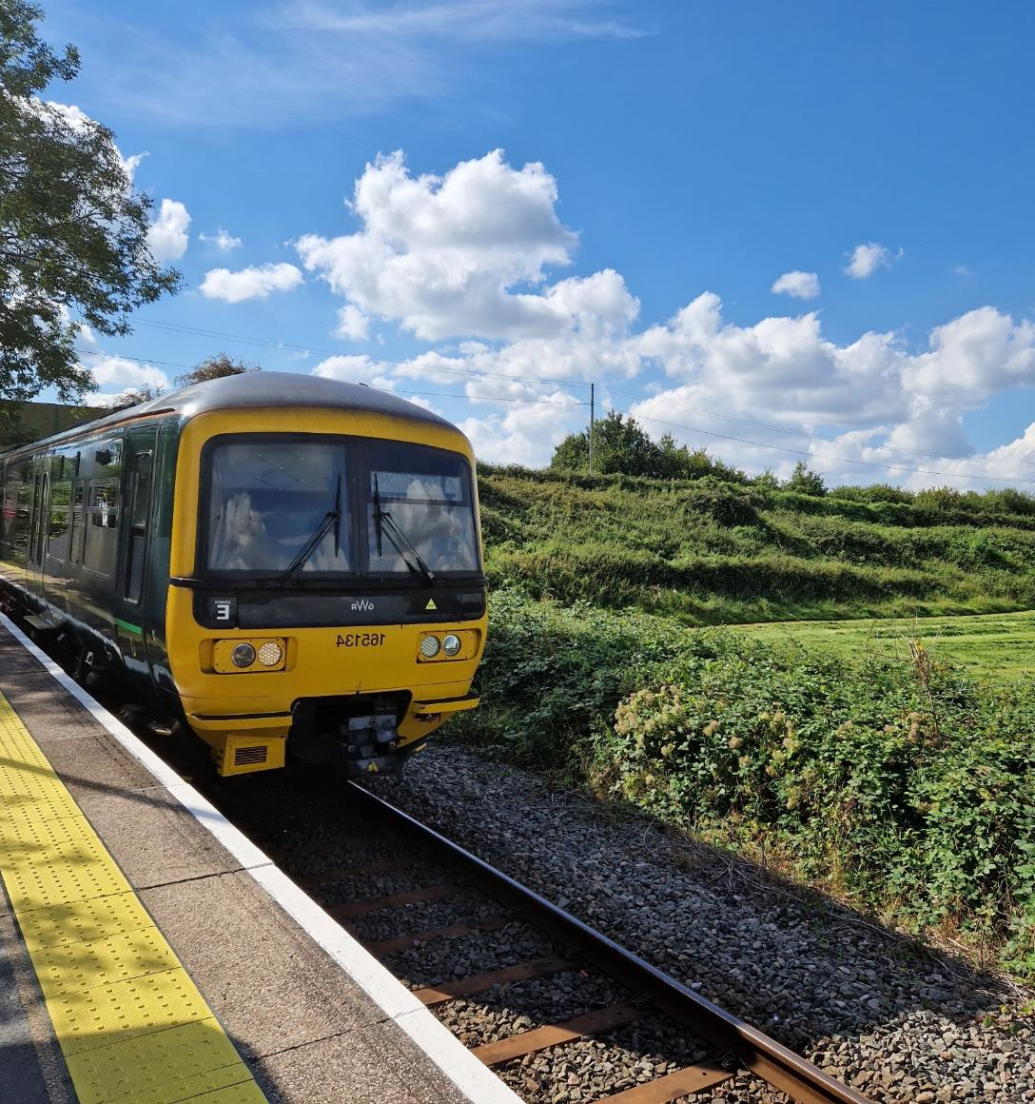
Heart of Wessex Line

Slide 16

Enabling Delivery
Sarah Valentine – Head of Analysis and Appraisal
28 February 2024
Notes:
Intro
Team
Focus on supporting delivery

Slide 17
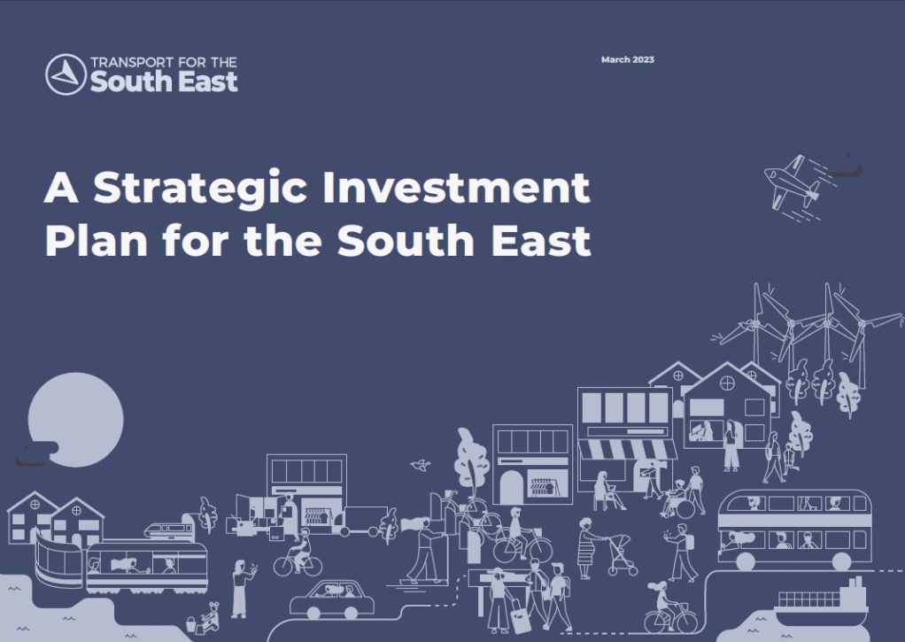
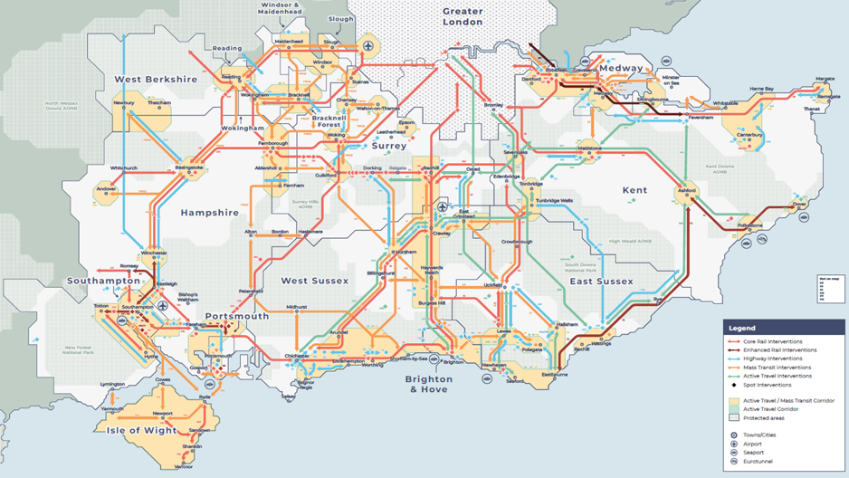
Strategic Investment Plan
So what?
Notes:
A strong and compelling narrative for the South East making the case for investment in the strategic infrastructure required to deliver the vision set out in the transport strategy
Over 290 schemes, policy interventions – all good
But so what?
No point having a glossy document to sit on a shelf
What are we actually going to do about it?
How are we going to deliver the schemes and policy interventions?

Slide 18
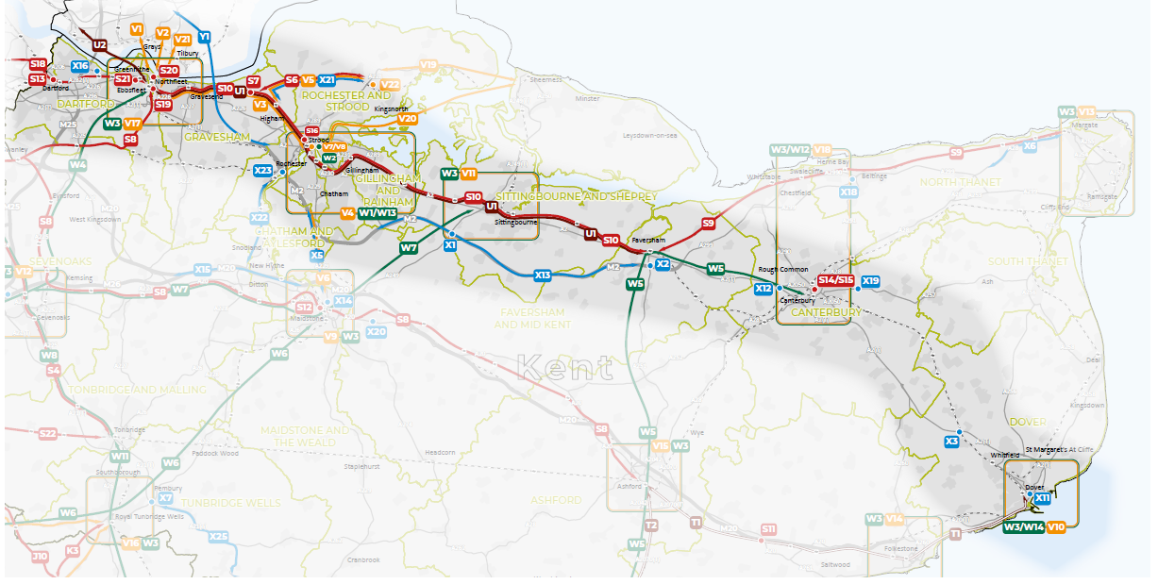
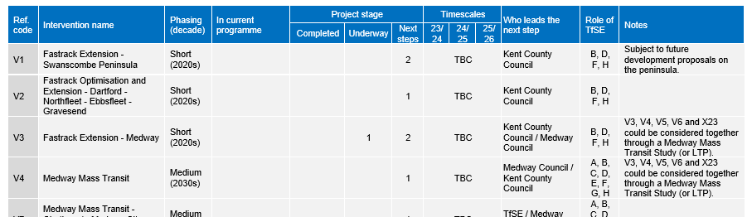
Delivery Action Plan
  SE1 corridor – M2/A2/Chatham Main Line (Dartford – Dover)
Notes:
Worked with you as our delivery partners to understand
Where each scheme is, what has already been done
What is the next step
Who is base placed to lead the next step
What resources will be required – funding, analytical tools etc, or advocacy
Phased Delivery Action Plan that focuses on:
activity in the next three years for delivery partners,
role of TfSE,
scope for resource funding to accelerate early-stage development,
approach to capital investment pipeline development (e.g. RIS3, RIS4 Pipeline, RNEP for CP8/9, MRN 2)
baseline for monitoring and evaluation
(SIP modal for good reason analysis) DAP Loops back to ECR – focusing on strategic economic corridors
Aids holistic delivery – how schemes interact, what else is happening, schemes can be designed to take account of each other
NH making provision for KCC bus lane during junction upgrade
Improving interchange facilities at stations if mass transit and active travel schemes planned in vicinity
Strategic prioritisation – everything in SIP is a priority
£46bn was affordable – in line with historic transport spending – but now in more challenging times, less funding, inflation….
Can’t do everything at once
Evidence based – using multi-criteria assessment framework from AS – strategic fit, costs, benefits, deliverability
Know we are going to be asked to prioritise – eg RIS
Modal based at mo – what if more holistic
Funding challenges – what if less funding? (or more?)
Would the top 10 be the same, or would there be smaller quick wins
Scenario based approach to help us work through

Slide 19
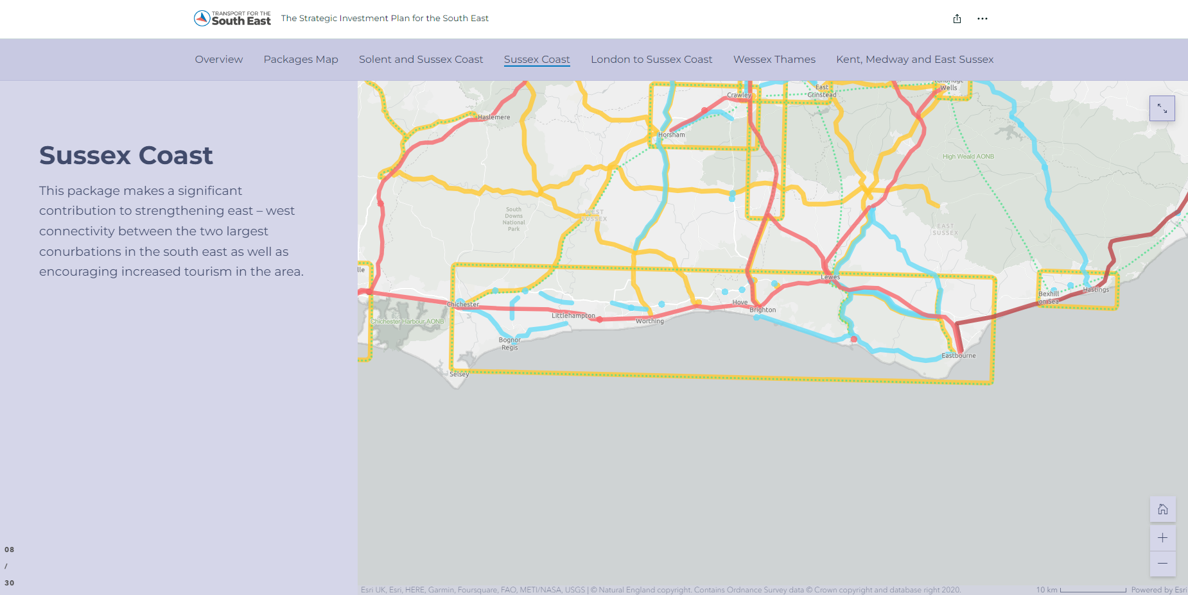
Notes:
Sussex Coast
This package makes a significant contribution to strengthening east – west connectivity between the two largest conurbations in the south east as well as encouraging increased tourism in the area.
Sussex Coast Rail
Network Rail has worked with local transport authorities to develop a package of improvements in the West Coastway Strategic Study, formerly Connectivity Modular Strategic Study Plan (CMSP), that deliver faster journeys and more capacity between Brighton and Hove and Southampton.
This will support faster inter-urban and longdistance journeys between the south east’s two largest conurbations. The key benefits of this package are:
Faster journeys between Brighton, Chichester, Portsmouth and Southampton.
Potentially more frequent, longer-distance services between Brighton, Chichester, Portsmouth, and Southampton.
Additional capacity between Worthing and Brighton for shorter journeys.
10,000 additional rail trips each weekday
Sussex Coast Mass Transit
Brighton and Hove City Council is developing plans for a high-quality public transport system along the Brighton seafront. The details are to be finalised, but the topology of the city lends itself strongly to bus rapid transit (e.g. more frequent “turn up and go” and faster services on dedicated bus lanes and other priority infrastructure).
TfSE and its partners have carefully considered whether this system could also serve East and West Sussex. At this stage, extending to East Sussex appears to be more feasible than West Sussex.
Additionally, East Sussex is developing proposals for improved public transport services in Eastbourne and Hastings. All these systems could be supported by general improvements to local bus services and strategic mobility hubs, notably at Falmer and Polegate. (options for other hubs are more challenging but should be explored). These hubs will improve access while helping to reduce vehicle traffic in urban areas.
It delivers a “world class” mass transit system with significant mode shift from car to bus services and provides an attractive and sustainable option for east – west local journeys along the south east coast. It also reduces carbon and boosts GVA by over £100 million each year by 2050.
Over 100,000 more mass transit trips each weekday, with 65,000 fewer car trips
Sussex Coast Active Travel
All three local transport authorities on the Sussex Coast have ambitious plans to reduce congestion and public health outcomes by increasing rates of cycling and walking in their areas. This package aims to help these authorities realise this ambition.
Improving the quality and attractiveness of active travel infrastructure will give people greater transport choice and reduce the demand for private vehicle trips on local roads and the strategic highways network, making better use of existing roads and reducing the need for some more expensive highways capacity improvements.
Several smaller scale highways interventions are also included to support housing growth along the Sussex Coast. Most of these interventions also include public transport and active travel elements.
The key benefits of this package are:
Material improvements to the urban realm of the Sussex Coast built up area, unlocking active travel and regeneration opportunities, as well as encouraging increased tourism in the area.
Improvements in air quality in urban areas.
Significant potential mode shift from car to active travel, with associated health and wellbeing and road space efficiency benefits.
5,000 tonnes less CO2 equivalent emitted a year
Solent and Sussex Coast Highways
Targeted, integrated interventions to deliver high quality east – west connections for freight, private and mass transit vehicles (notably, buses) that de-conflict local and longer-distance traffic, with the greatest benefit when supporting and supported by public transport improvements.
Interventions that deliver safer highways, notably in urban areas, and support access to international gateways, regeneration and growth areas, and placemaking (e.g. unlocking public spaces) are featured.
This package has been refined to minimise carbon emissions and the impact of these interventions on the wider environment.
The interventions aim to deliver modest improvements to the Strategic Road Network that focus on segregating strategic and regional traffic rather than materially lifting capacity along the whole corridor.
Further mitigation will be needed as these schemes are developed. They will also be complemented by the global policy interventions discussed above, which will accelerate the decarbonisation of road vehicles and mitigate the adverse impacts of this package.
A better designed highway network will deliver improved air quality in urban areas and reduce the impact of road traffic on the South Downs National Park

Slide 20
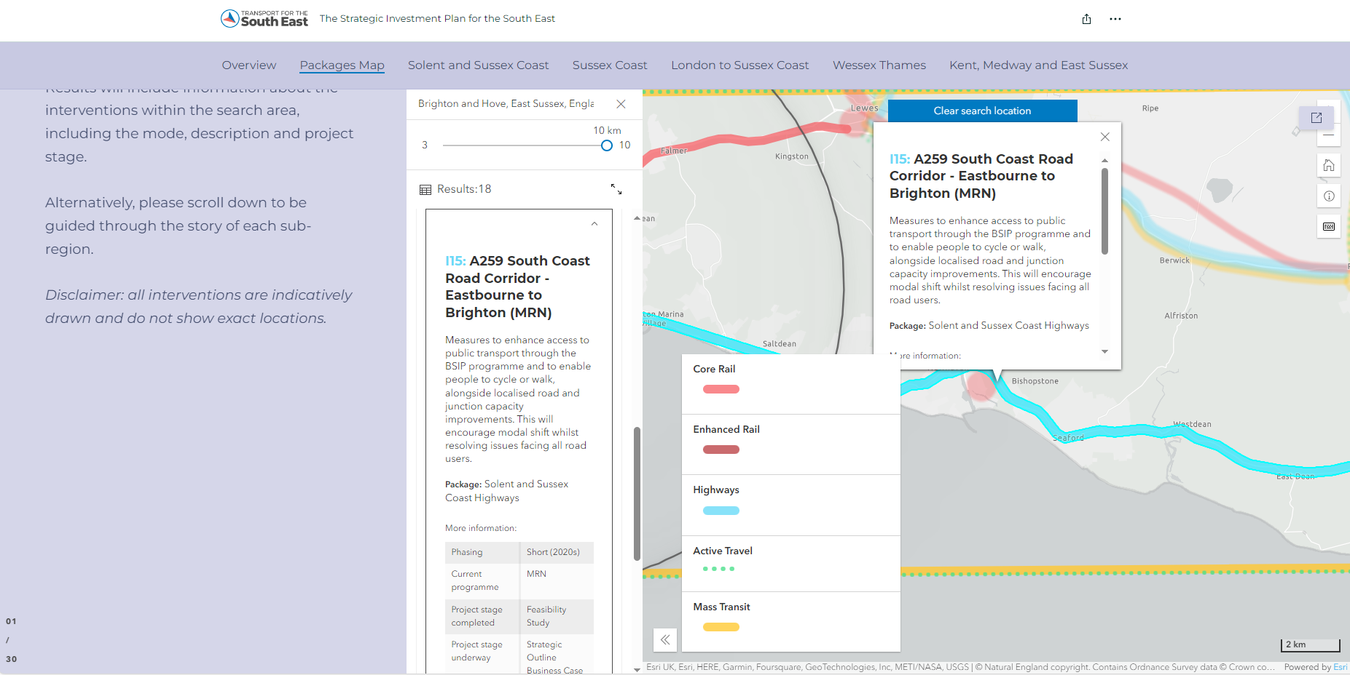
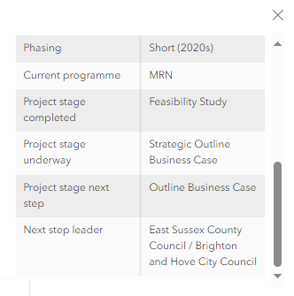
Notes:
Fly in box

Slide 21



Prioritisation Framework rationale
STB Core Function:
“provide advice to the Secretary of State on prioritising transport investment”
3 types of decisions, when to:
Study Develop Deliver
Notes:
Department for Transport: Business plan guidance requires sub-national transport bodies to provide advice to Ministers on the prioritisation of transport investment across their geographies
Transport for the South East: took the decision to develop a Strategic Prioritisation Framework (“framework”) and supporting analytical tool to inform three types of decisions with respect to prioritisation
Deciding what to focus revenue study money for early-stage scheme development on
Defining the timing and relative priority for interventions that require further development
Defining the timing and relative priority to deliver interventions
The framework has been developed through engagement with the Transport Strategy Working Group, Senior Officer Group and Partnership Board

Slide 22
Framework key principles
Evidence Led
Resource Efficient
Manage Uncertainty
Supports Decisions
Notes:
Be evidenced
The framework should make best use of available evidence that is consistent
Support decisions
The framework should support decision-makers but does not make decisions
Resource efficient
The framework should not re-analyse schemes in the Strategic Investment Plan, but carry forward analysis
Manage uncertainty
The framework should aid TfSE and partners in navigating an uncertain funding environment

Slide 23
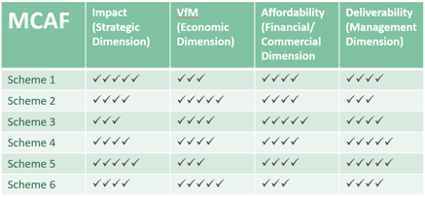




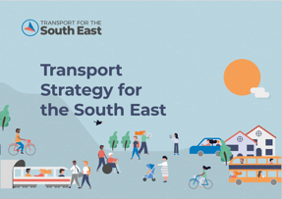


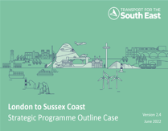
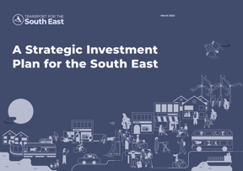

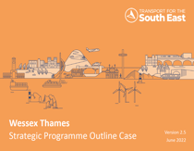
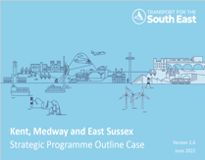




Prioritisation tool methodology
Organise
Evaluate
Finalise Plan
Score
Iterate and collaborate
Notes:
The framework can support prioritisation using a tool that can consider a number of different scored criteria or wider scenarios (e.g. funding envelopes)
The framework sorts interventions into five-year windows identifying whether the intervention will be studied, developed or delivered (or a combination thereof) in each window
It can produce prioritised lists or ‘action plans’ that can inform decision-making and guide action from today to 2050 in five-year increments under different constraints or scenarios
1) Organise
Define each intervention based on its current stream (study, develop, deliver)
(2) Score
Assemble evidence and score on impacts (e.g. areas of benefit and value for money) and requirements (e.g. affordability and deliverability)
(3) Evaluate
Define which interventions will be identified for potential study, development, or delivery based on their scores and the criteria constraints
(4) Finalise Action Plans
Finalise the allocation of schemes to the action plan after initial feedback

Slide 24
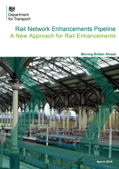
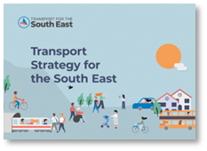
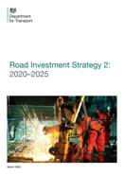


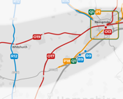
Managing uncertainty
££
£
-£
3
6
2
5
1
4
Notes:
Moderate increase in funds, funding is predictable (+2% per year)
Limited to today’s existing funding levels based on average annual expenditure 2011-2022
Decline from historic funding (-2% per year)
Today’s decision-making advocate, but not decide (organise by programs in line with central government funding pots)
Delegated authority to TfSE and partner (organise based more on TfSE’s perspective)

Slide 25
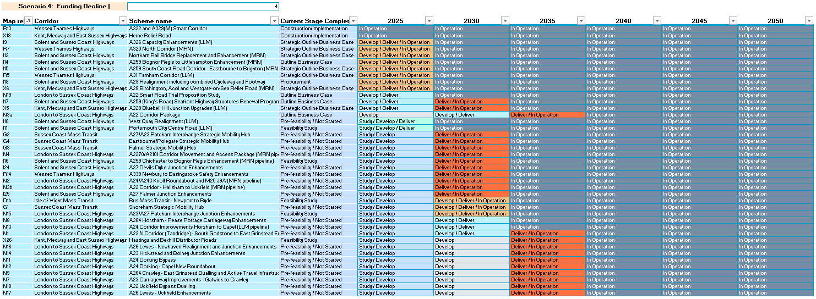
Outputs

Slide 26
Thank you
Find out more
tfse.org.uk
Get in touch
tfse@eastsussex.gov.uk
Follow us
@TransportfSE

