Slide 1



11.05-11.50
Wicked challenge: EV transition
Framing the challenge: Shayne Rees, Partnerships Consultant, char.gy
STBs’ collective expertise: Simon McGlone, Senior Planning and Strategy Officer, TfN
^{WITH}
^{SUPPORTED BY}

Slide 2
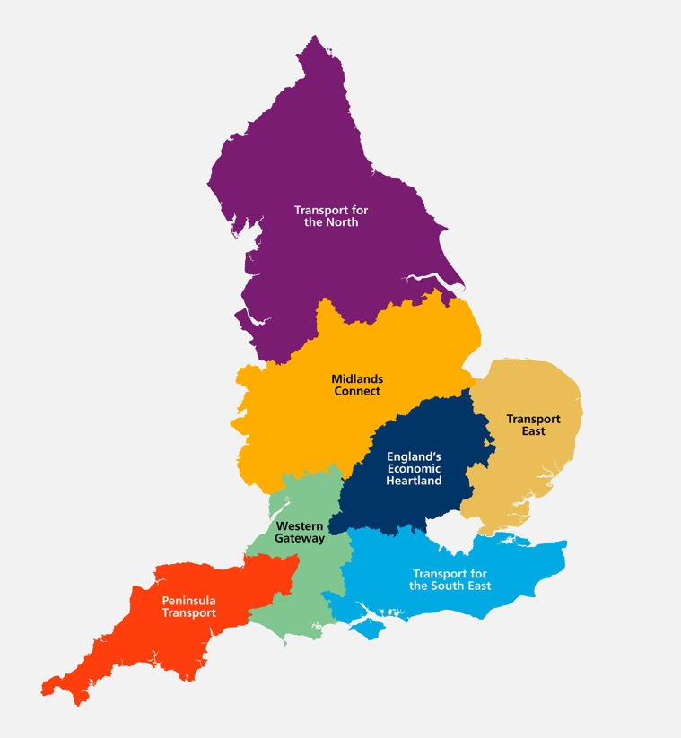
Sub-national Transport Bodies (STBs) - enabling the scale and pace of EV charging delivery required.
Acting as ‘one voice’ for a region - communicating place based strategic needs and helping to shape national picture.
Consistent approach to cross-boundary nature of EV and reducing road carbon emissions.
  Holistic & integrated planning - planning for a whole network outcome which delivers for road users where there is a need to drive.
  Supporting & enhancing local, regional and national planning and delivery.
Trusted analytics to support regional objectives for decarbonisation, social inclusion and economic growth.
Accelerate actions through convening power - facilitation and collaboration (brokering public and private sector collaborations or bringing key interacting sectors together).
Notes:
Progress? Ref National EV Strategy. Scale and pace of delivery…..positive change in last 2 years, the pieces are there for rapid progress, STBs playing a role in enabling that….
Panellists will provide insight into the role STBs are playing on EVs and charging, including:

Slide 3
11.05-11.50
Wicked challenge: EV transition
Midlands Connect and its role in joining up LA’s to bid collectively for LEVI funding
Vanessa Strange, Head of Infrastructure Investment, Lincolnshire County Council
Penisula Transport/Western Gateway present headline findings from joint studies on electric vehicle charging and alternative fuels for freight
Hannah Shrimpton, Programme Director, Peninsula Transport
Providing a comprehensive and consistent view of EV charging needs via the EV charging infrastructure framework
Simon McGlone, Senior Planning and Strategy Officer, TfN
^{WITH}
^{SUPPORTED BY}

Slide 4

Midlands LEVI Consortium….
The Pilot
Vanessa Strange
Head of Infrastructure Investment

Slide 5



Midlands LEVI Consortium – the pilot
Being funding ready – to accelerate charging across the East Midlands
Strategy document provided the launch pad to bid
STB to LA relationships provided the confidence to commit

Slide 6
What did we promise?
The project was successful because of its approach and innovation.
A desire from partners to test and learn
Just under £1 million in grant funding to deliver >349 charge point sockets, with an aim to bring in £2.8-£5.6 million in private investment.

Slide 7

From SOBC to procurement
Growing and developing partnerships
Growing developing deep technical knowledge
Using experts within STB, LAs and consultants where needed:
  Eg: legal, MOU, procurement, market engagement

Slide 8

Reflections
Scale
Support
Greater interest due to scale
Greater focus on EV for LAs
Need for more specialist resource and growing our own
Resource required for partnerships

Slide 9

EV and Alternative Fuel Transition in the South West – Rural and Seasonal Challenges

Slide 10
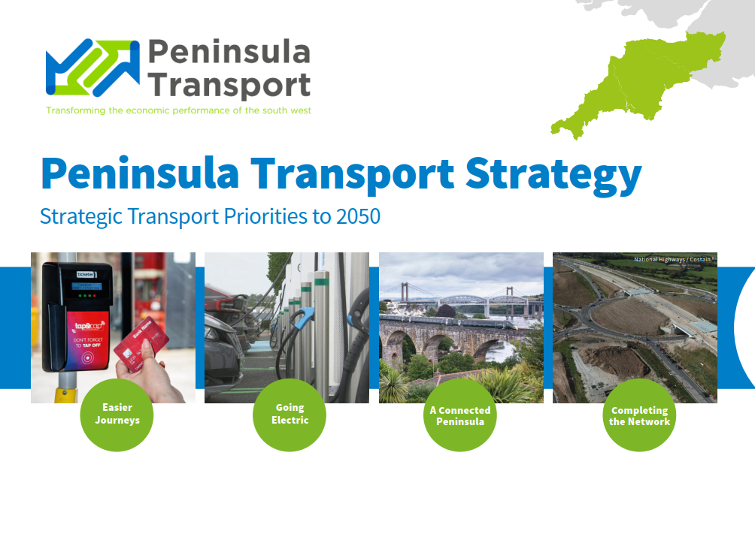
Notes:
Summary of Peninsula Transport Strategy and one of the four key outcomes being ‘Going Electric’
By way of brief introduction, Peninsula Transport and Western Gateway have undertaken an EV infrastructure demand forecasting exercise, with WSP, to understand the future demand for EVs and therefore chargepoints in coming years. Alongside this, both Peninsula Transport and Western Gateway have been preparing their Transport Strategies.
Peninsula Transport have recently gone out to consultation for their Strategy and are working towards adoption of the strategy at our next Board on 7th March. The Strategy features four key outcomes by 2050 – one of which is ‘Going Electric’ – aimed at facilitating the rollout of alternative fuel infrastructure across the region.
What I’m focusing on in this presentation are two key challenges in the South west – Rurality, and Seasonality.

Slide 11
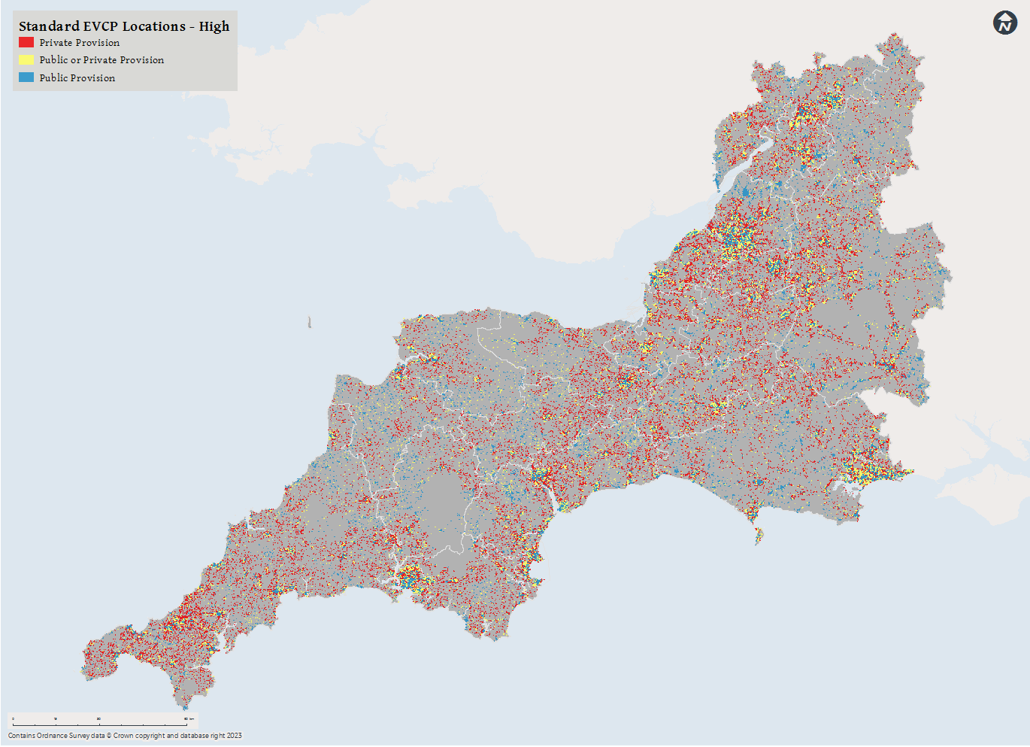
South West EV Infrastructure – the Rural Challenge
Third of population are ‘rural’ in South West – almost 50% in Peninsula
Commercial viability is a challenge
Almost 20,000 EVCPs required to be provided by the public sector in a ‘high uptake’ scenario by 2030
Locations for off-street facilities are not always available in rural settlements
Notes:
Credit WSP. Note – numbers are based on publicly accessible EVCPs – both in car parks and on-street
Difficult to see on image but areas with blue dots are forecast to be reliant on public intervention to install EVCPs
Viability – short term. As the network reaches ‘tipping point’ the delivery model may become more commercial and therefore less reliant on public sector however currently this shows significant public sector intervention in the South West
By way of context – there were 2,408 public chargepoints in SW in Jan 2023.
Cost neutral network is essential for the public sector to deliver this infrastructure in the short term due to pressures on funding and resources

Slide 12
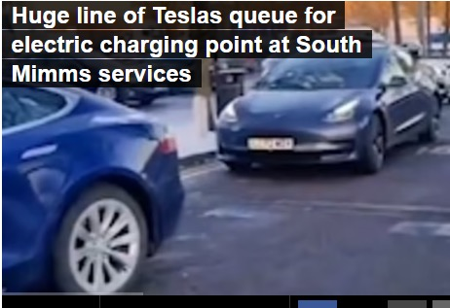
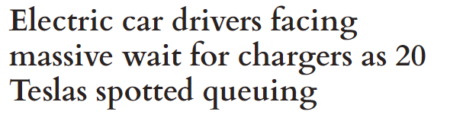
South West EV Infrastructure - Seasonality
Notes:
Christmas 2023 – headlines
Whilst these were no doubt exaggerated and exacerbated due to the concentrated travel period during the festive period, it highlighted a growing issue which is of real concern in the Southwest around meeting the demand of the visitor economy

Slide 13
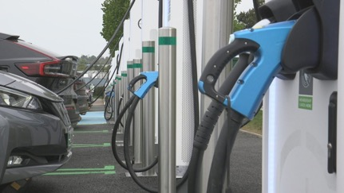
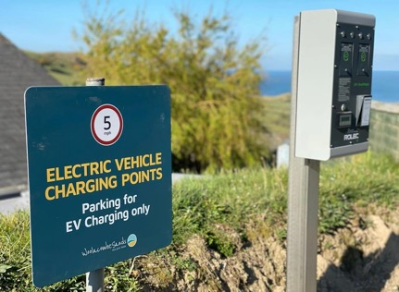
South West EV Infrastructure - Seasonality
Addressing needs of seasonal visitor demand for EV infrastructure is essential to retain and grow tourist economy
Peninsula region has 18million visitors per year
25% increase across South West in traffic during summer months
Forecast to lead to 22% increase in EVCP demand during these peak periods
‘Destination charging’ could form part of the solution
Notes:
Some parts of the SRN in Peninsula increase by 70%. Confidence in the ability of visitors to charge is key.
Exeter Services – second most popular EV charging location in 2022 in UK.
Pic – Woolacombe Holiday Park
Destination parking at attractions, accommodation and resorts
As well as improved sustainable transport options at destinations

Slide 14
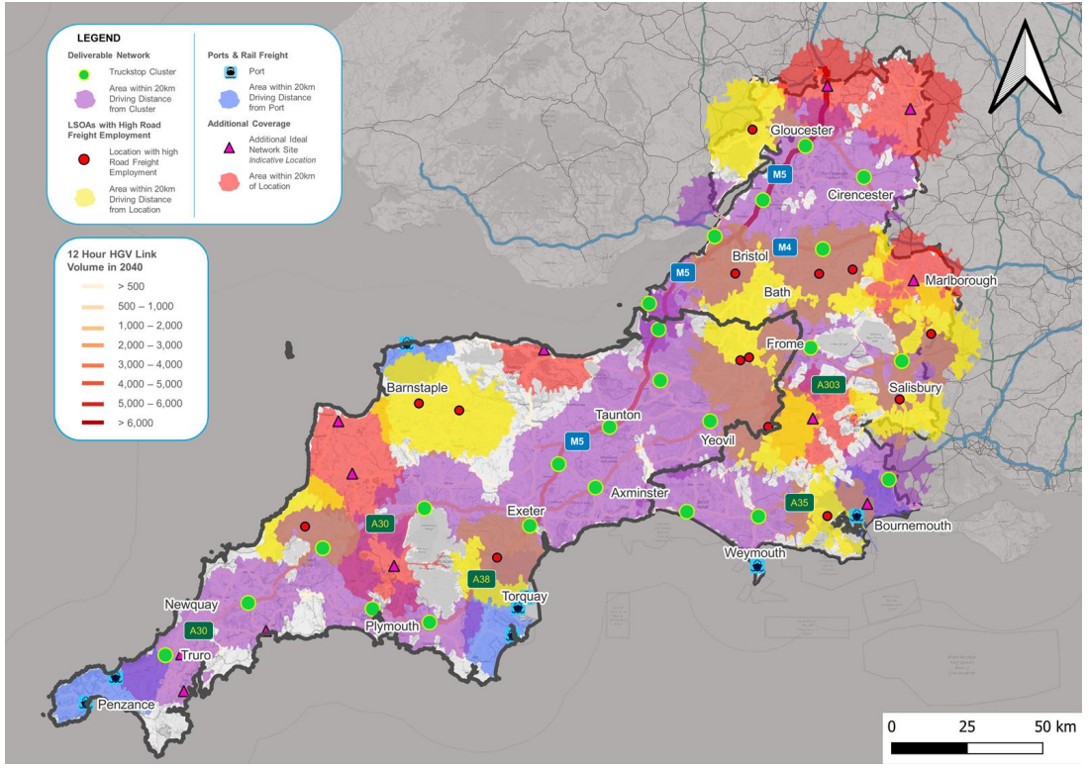
Alternative Fuels for Freight – South West challenge
Limited current provision of any alternative fuels
24 potential cluster locations identified across region
Stakeholder concern around network capacity and ownership of responsibility
Notes:
Credit Cenex & Atkins
This study really highlighted the considerable challenge for the southwest in offering ay real alternative fuel solutions.
Each green dot represents a potential ‘deliverable’ location on the SRN.
The limited extent of the SRN in the Southwest means that solutions are also required away from that network.
Red dots signify locations with high road freight employment, and therefore freight movements and could be used as additional fuelling locations. The colour shading shows 20km drive catchment of each of the points – evidences that there still significant gaps in some parts of the region.

Slide 15
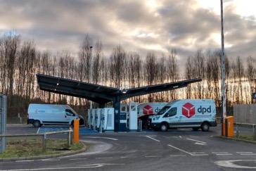
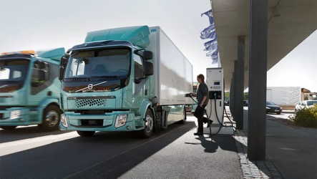
Next Steps for the South West
Bring together stakeholders – DNOs, operators, OFGEM, hospitality and tourism sectors and local authorities to make tangible progress
‘Going Electric’ priority outcome for Peninsula Transport Strategy gives us remit
LEVI support and monitoring
Rural mobility solutions a priority
Promoting expansion of ‘destination charging’
Alternative Fuels for Freight Site Selection tool – optimizing freight fuel options
Notes:
With the adoption of Transport Strategies across both Peninsula Transport and Western Gateway, both STBs can now look to developing our EV infrastructure plans.
Bringing together the main players across the region will be the first step towards a coordinated and consistent approach.
The clear priority outcome in Peninsula Transport Strategy gives us the mandate to push on with advocating for EV infrastructure expansion.
We will work with local authorities to support LEVI bid outcomes,
Rural mobility – alongside EV we are working on a series of rural mobility pilots which as considerable overlap with this work
Expansion of ‘destination charging’ and working with the tourism sectors to ensure this is prioritised
Building on the Alt fuels for freight work to consider and promote optimum locations for commercial/freight refuelling locations, working with the private sector and our regional freight forum to facilitate this.

Slide 16

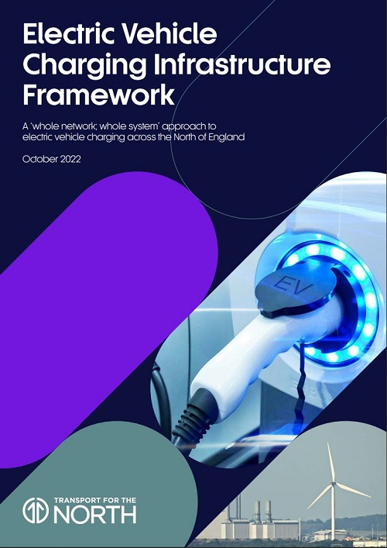


Transport for the North:
EV Charging Infrastructure update

Slide 17
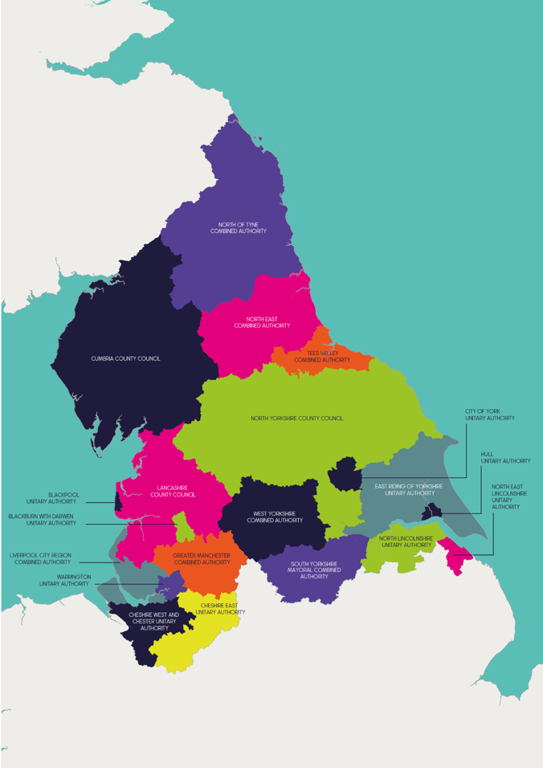
Regional EV Regional Partnership Group
Collaborative partnership which consolidate multi-agency approaches, sharing intelligence and actions to deliver mutual goals.
Transport for the North
TfNs member organisations (Northern Local Transport Authorities or LEP representatives).
National Highways
Network Rail
Department for Transport / OZEV
Scottish Power Energy Networks
Electricity North West
Northern Powergrid
Energy Saving Trust
Ofgem
Ordnance Survey
Notes:
WHOLE NETWORK VIEW
A full and effective network, which is resilient and flexible requires a mix of charging solutions.
WHOLE SYSTEM VIEW
Gain a better understanding of likely electricity grid requirements, constraints and implications….but also the solutions, when making deployment decisions.
About efficiency of multi-agency delivery, informing decisions made elsewhere and supporting a holistic approach to what can be large scale interventions
Steering Group Objectives:
To shape and support the effective evidence development and supporting capabilities as set out in TfN’s EVCI Framework, which aims to enhance local, regional and national decision making activties.
To develop a tangible evidence base to support user-centred, placed-based and outcome-focused outcomes for EV charging infrastructure in the North, which supports objectives for both decarbonisation and inclusivity.
To facilitate constructive application and sharing of knowledge and collaboration across EVCI partner expertise across the North. Bringing multiple-agencies together to support delivery of a whole system approach through integration of transport, land-use and energy systems.
As a guiding principle, this group should seek to support clarity, consistency and a ‘joined up’ approach to EVCI where appropriate. TfN, via the EV Steering Group will seek avenues to promote awareness and communicate key messages and evidence supporting the shared vision for the North.

Slide 18
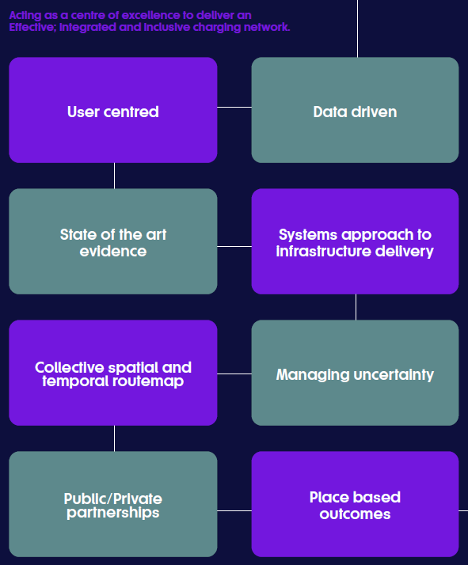
TfN’s ‘Whole Network’, ‘Whole systems’ strategy - objectives
Improve integrated whole network and place based outcomes for Electric Vehicles based on robust and data driven evidence of requirements - ‘the right infrastructure in the right place, at the right time’.
Provide a collective routemap towards an effective, attractive and inclusive network - ‘Supporting accelerated action right across the region’.
Create an attractive landscape for public and private partnerships – ‘Scaling investments’, ‘Capacity & Capability’.
Shaping whole system EV infrastructure decision making, and negotiating uncertainty - ‘Ensuring resilience and grasping opportunity’.
Go to TfN EVCI Framework webpage
Notes:
Progress since start – what we targeted….
Policy & recommendations – but we wanted to build something tangible
Routemap….Framework for outcomes we want to see.
Integrated but place based flexibility
Confidence

Slide 19
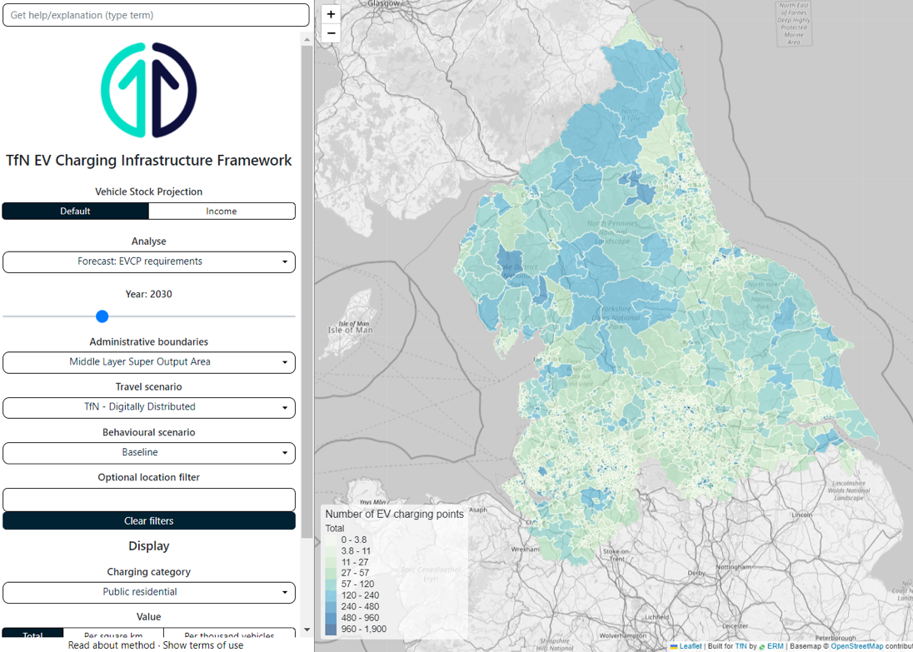
TfN EVCI Framework – an open source of charging infrastructure deployment needed
Applies TfN’s Analytical Framework - a highly innovative transport analytical suite.
Simple, openly accessible tool - access to evidence for charge point requirements across the region.
Credible source of evidence to support our national partners, local authorities and electricity DNOs in their planning and delivery activities (i.e. LEVI).
Strengthens communication of charging demand to CPOs, to encourage confident long term investment decisions.
https://evcivisualiser.z33.web.core.windows.net/
Notes:
Whole network view which informs Local Authority plans, strategies and delivery.
Evidencing and supporting public spend – LEVI & ORCS
EV strategies, Local Transport Plans, Local Area Energy Plans
Supported by TfN’s EV regional partner group
Advice to central Government and evidence charging requirements nationally. Strategy published Dec 2022. Developing a TfN ‘state of play’ report for 2024.
Informing delivery partner activities (i.e.):
National Government policy and legislation decisions
National Funding activities (LEVI strategy and RCF)
Rail North / Trans-Pennine Rail Upgrade
Electricity DNOs
Drawing in private sector interest and investment.
Shaping systems approach to facilitate accelerated delivery on pan-regional priorities. Data collaborations with DNOs, National Grid and Ofgem (new Regional Systems Planner strengthens the role of regional strategic planning).

Slide 20
What does charging demand across the North look like?
Total public chargepoints required: 51,200 – 90,900
By 2030
Total public chargepoints required: 143,000 – 220,200
Non-rapid: 39,200 – 64,900
Public en-route rapid chargers: 33,000 - 61,200
Current
By 2025
~8000 total chargers deployed (Zap Map)
En-route rapid chargers: 12,000 - 26,000
Public non-rapid: 110,000 - 159,000
Total power need 2030: 11,000 Gwh per year
(equivalent of 3m household usage)
Notes:
CAS - BAU and Accelerated Uptakes

Slide 21
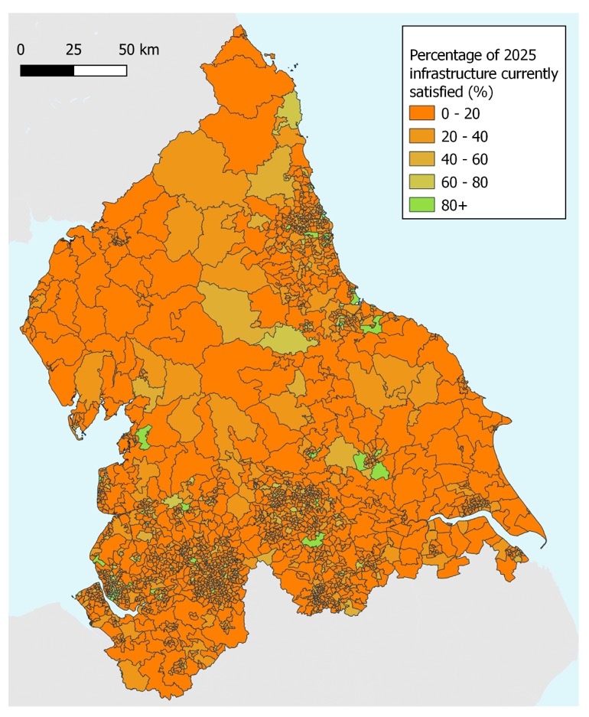
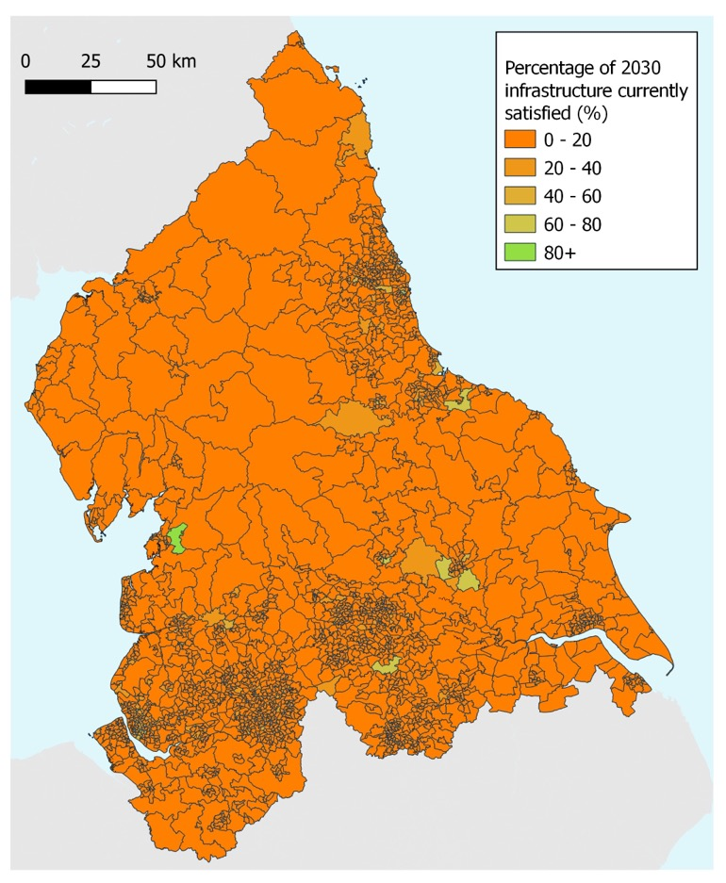
Monitoring deployment of charging infrastructure against identified requirements
Notes:
To monitor and evaluate delivery against future plans it is important to know where current infrastructure is located.
CAS accelerated EV uptake

Slide 22
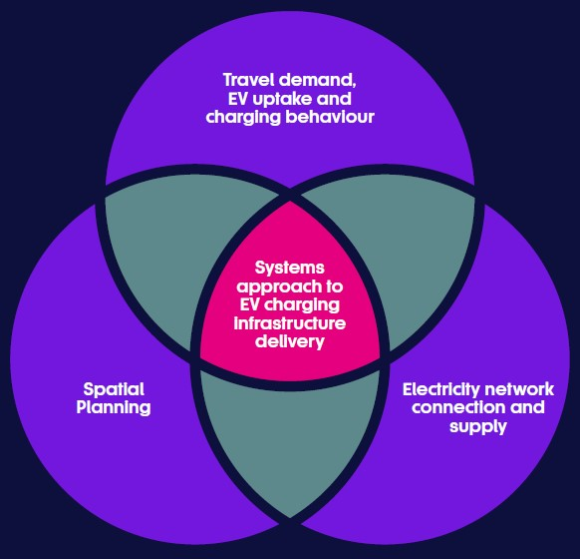
2024 EVCI Framework enhancements to support planning & deployment
Inform & support local, regional & national activities.
National roll out and integration of EVCI Framework across England via other STBs.
February 2024 updates – i.e. monitoring data, impacts of EV accessibility on charging, rapid charging demand mapping for major roads.
Energy collaborations – supporting energy partner decisions, applying data to understand grid capacity and headroom.
Spatial collaborations – Partnership with Ordnance Survey. Exploring geospatial data mapping for driveway access, public parking, on-street needs.
Commercial viability - whole network outcome to avoid social impacts of EV transition.
Better defining ‘adequate’ charging network and utilisation to understand queueing, dwell time, diversification of charging times and place-based delivery models.
Notes:
Exploring improvements and new data avenues - buses and depots; freight and warehousing; fleets; co-charging; land identification crowdsourcing and more…….

Slide 23
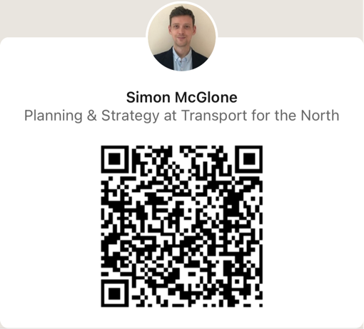

Thank you
Email: simon.mcglone@transportforthenorth.com
LinkedIn:

